Slide 1
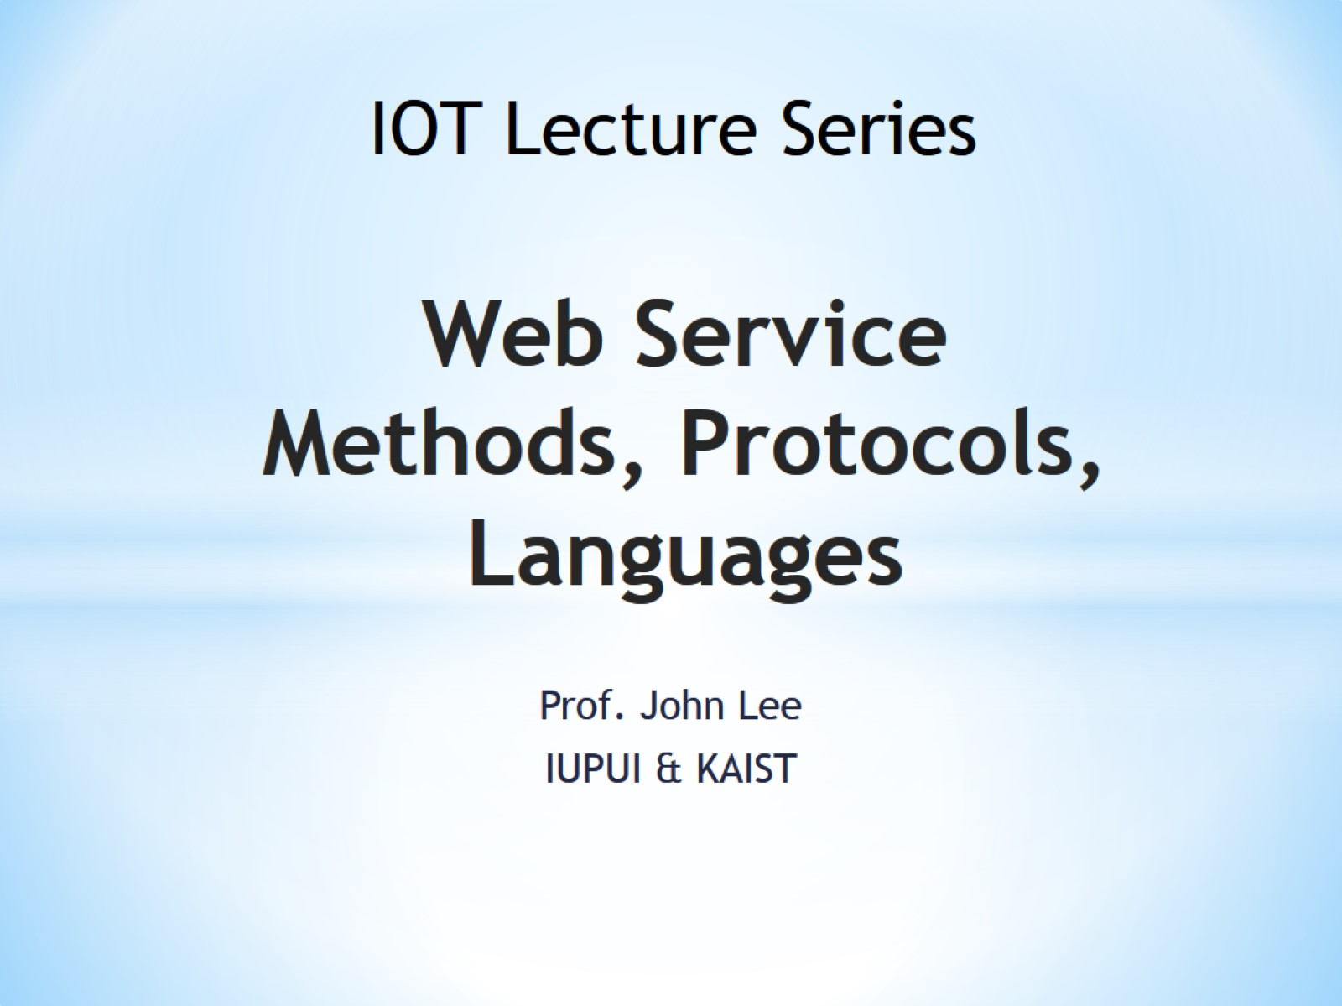
Web Service Methods, Protocols, Languages

Slide 2
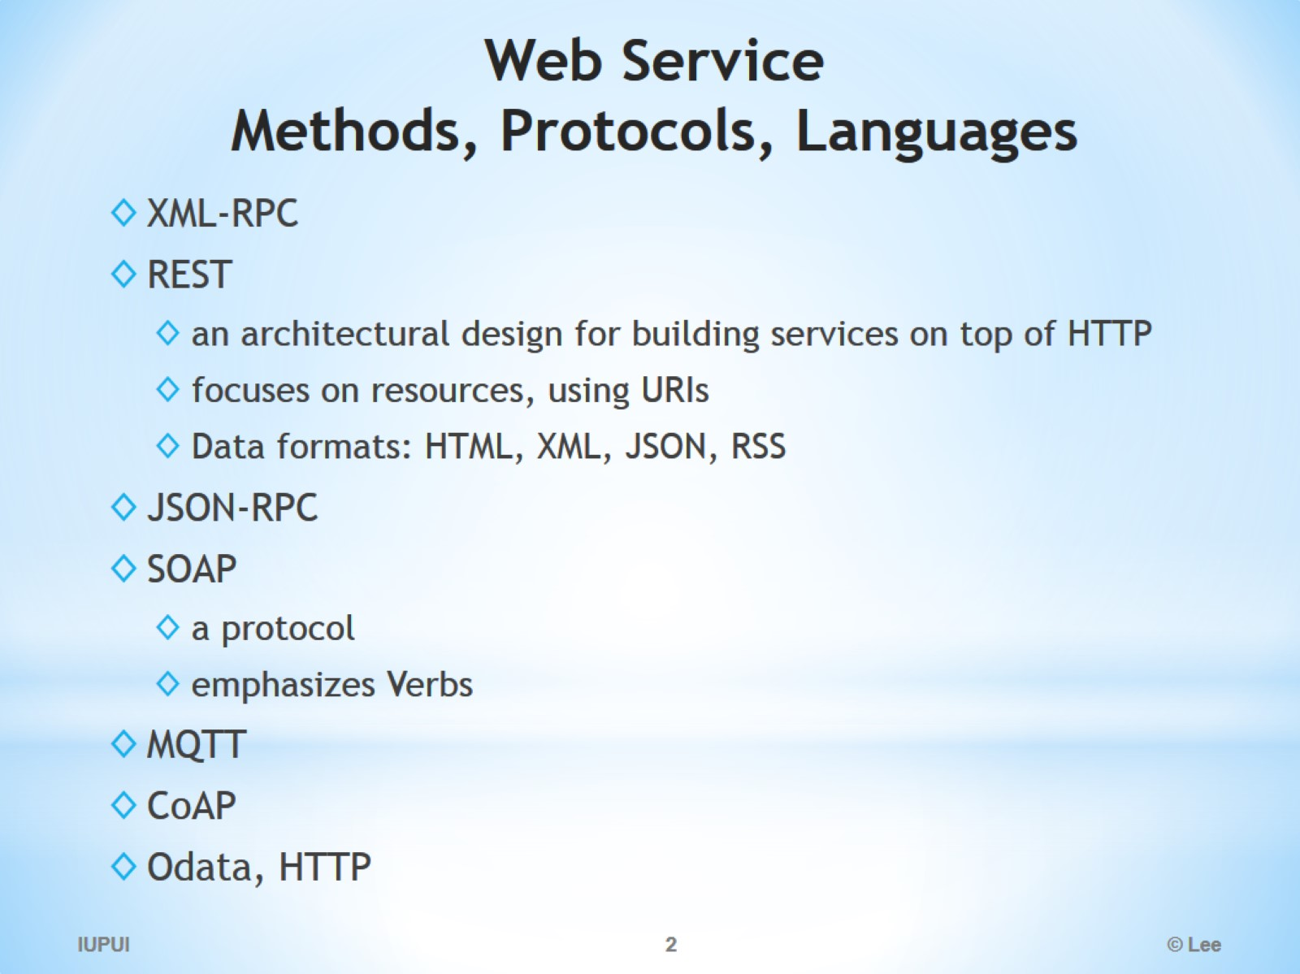
Web Service Methods, Protocols, Languages

Slide 3
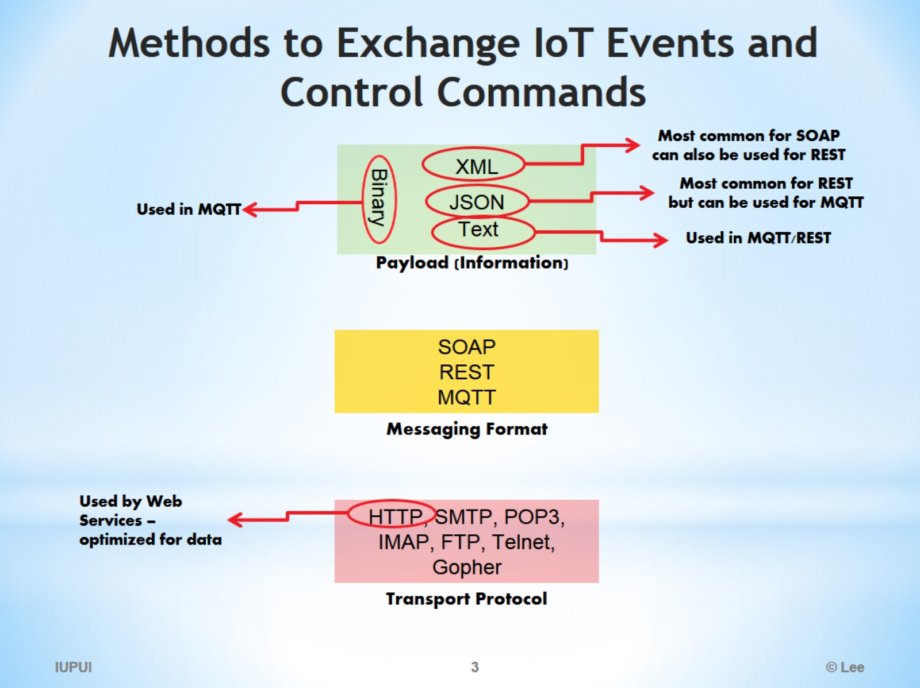
Methods to Exchange IoT Events and Control Commands

Slide 4
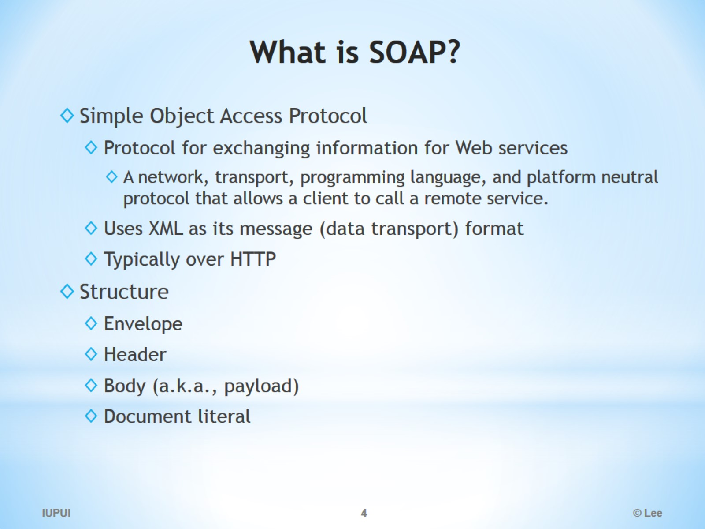
What is SOAP?

Slide 5
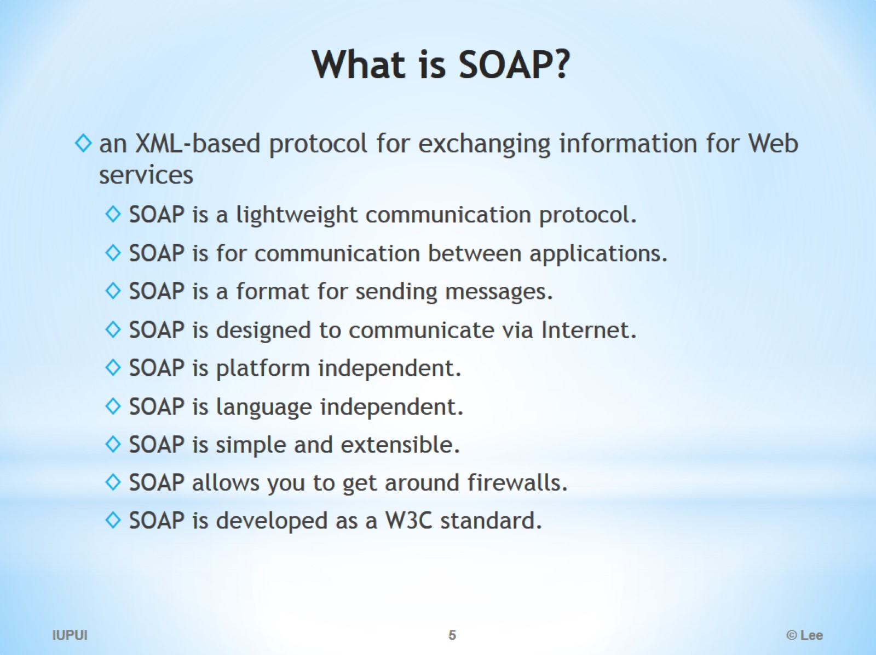
What is SOAP?

Slide 6
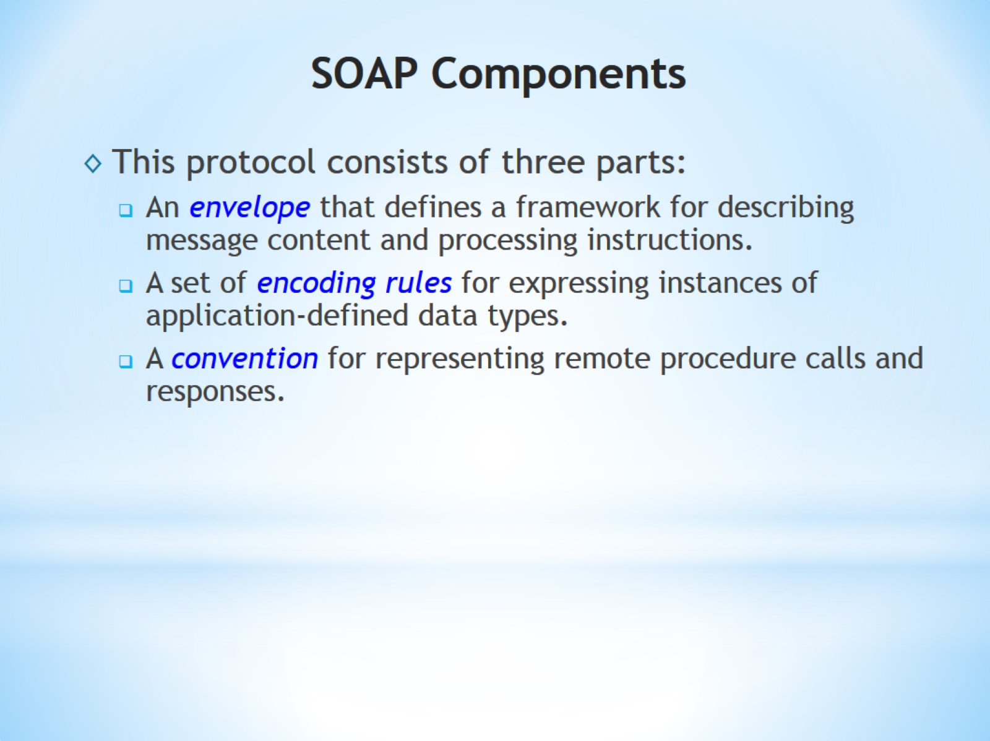
SOAP Components

Slide 7
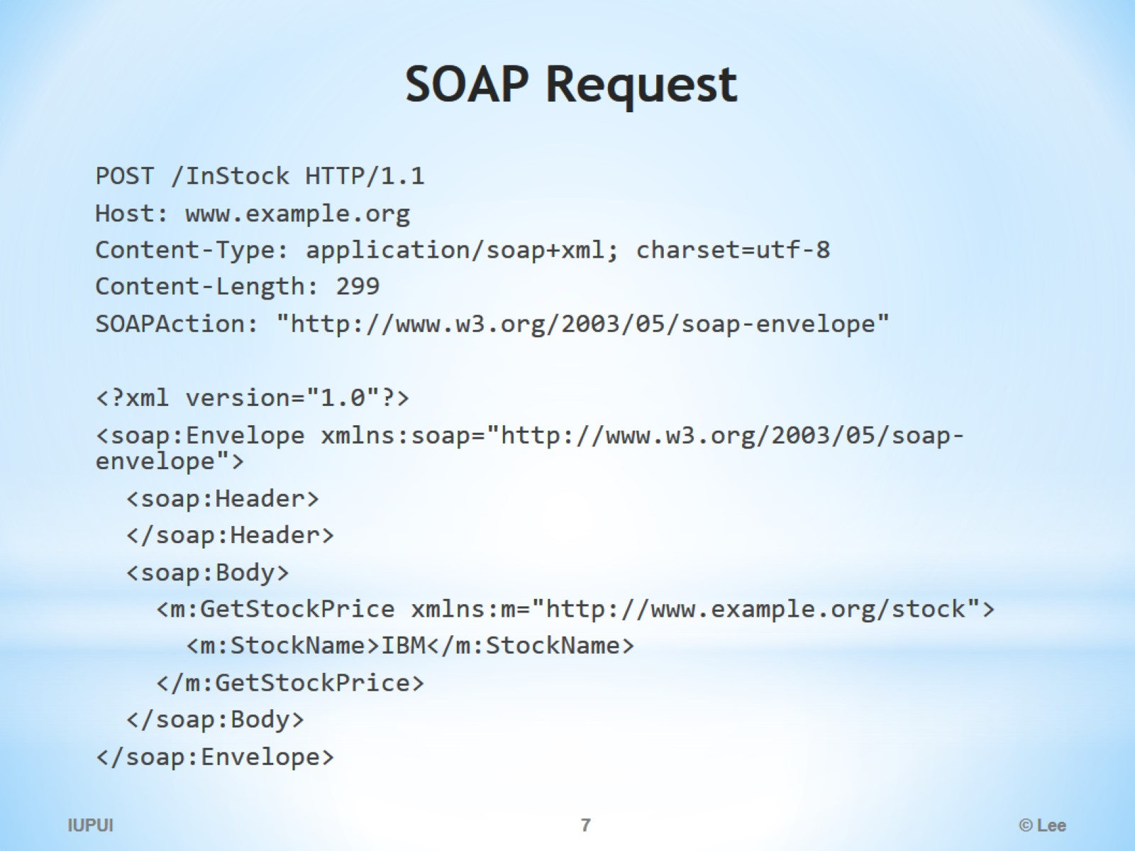
SOAP Request

Slide 8
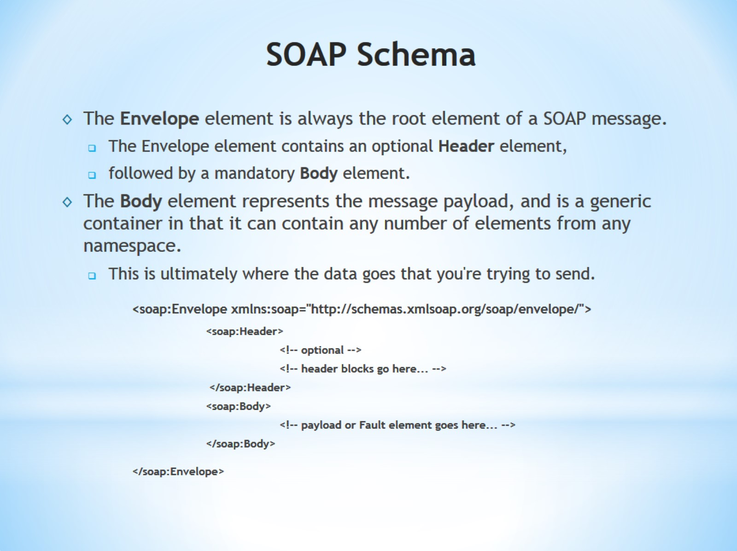
SOAP Schema

Slide 9
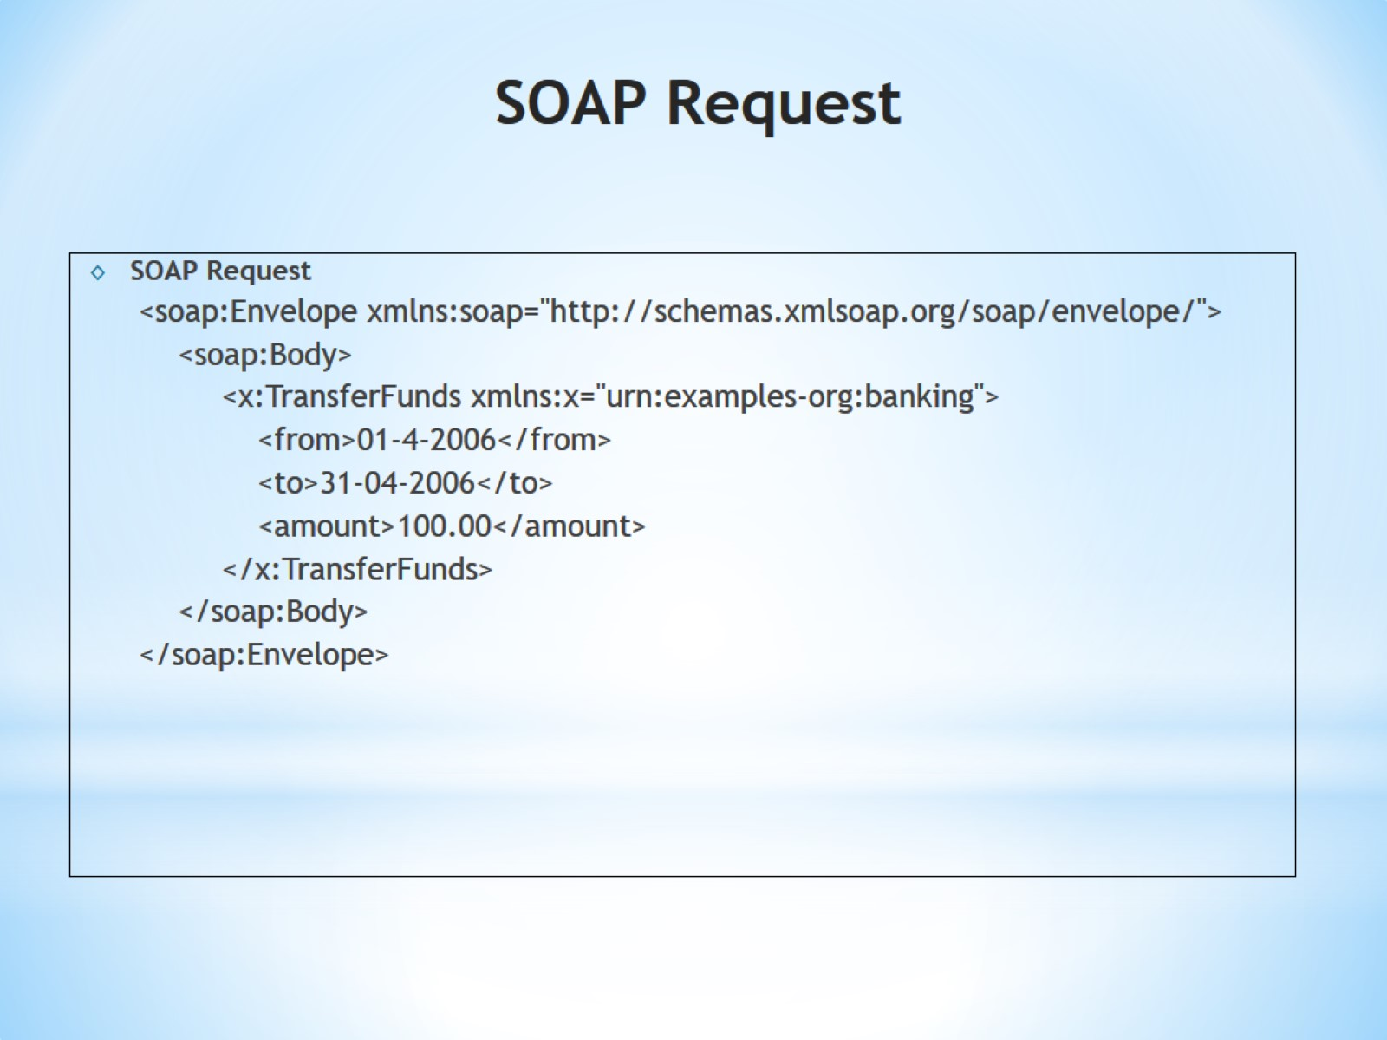
SOAP Request

Slide 10
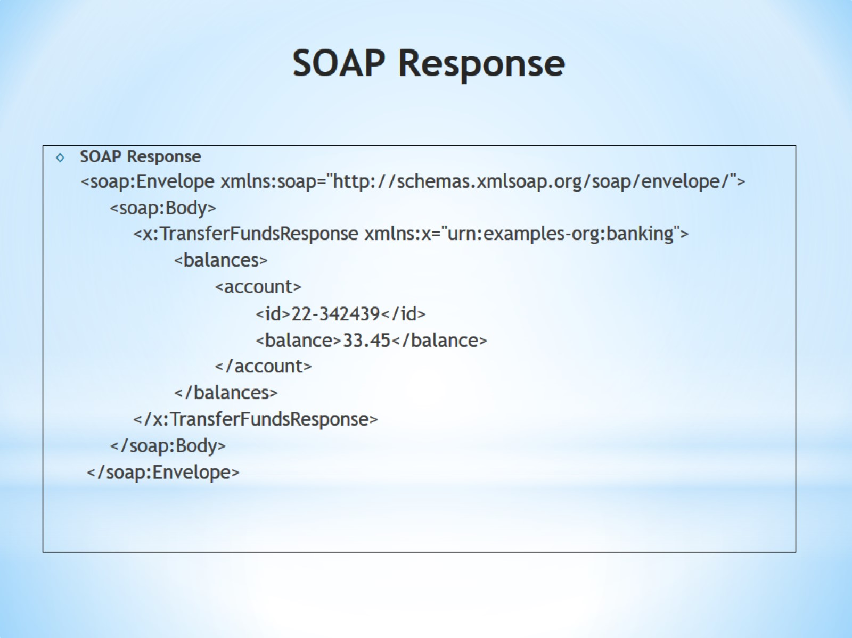
SOAP Response

Slide 11
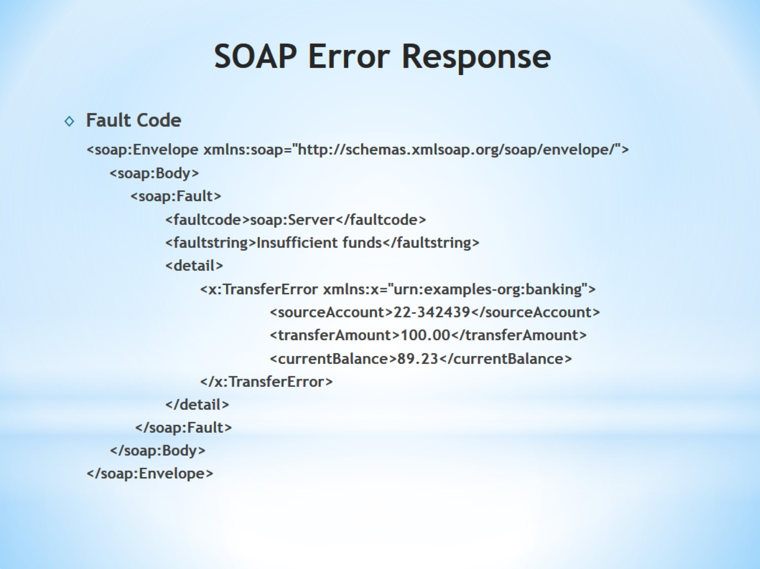
SOAP Error Response

Slide 12
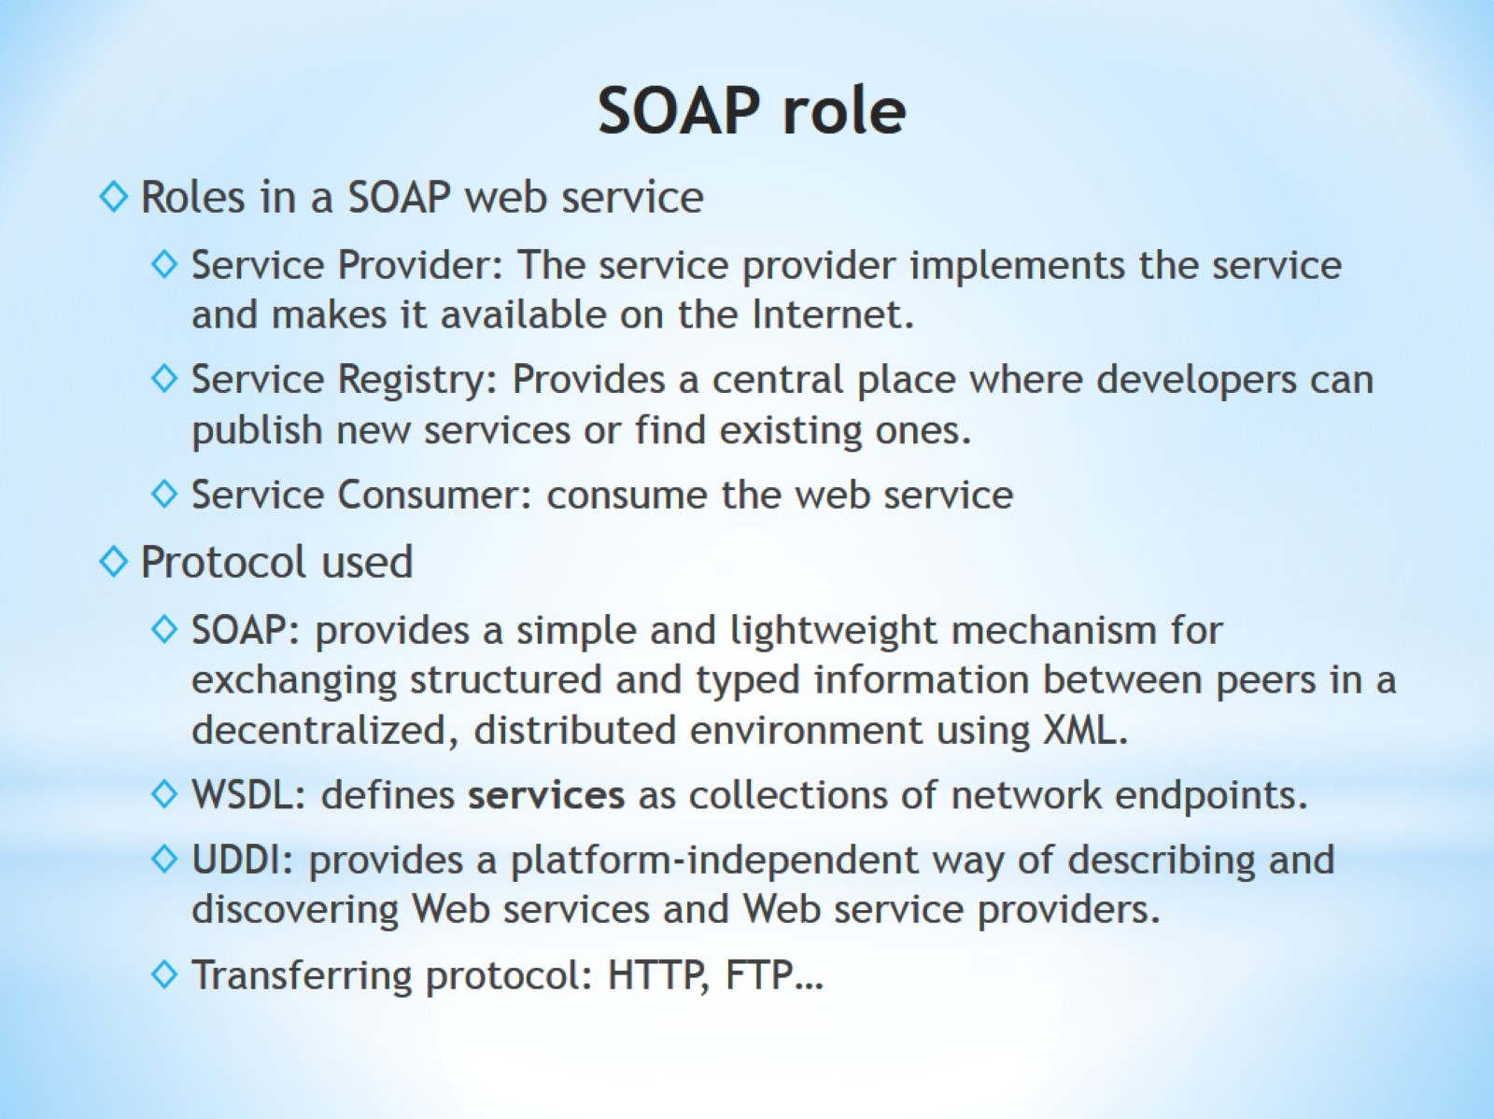
SOAP role

Slide 13
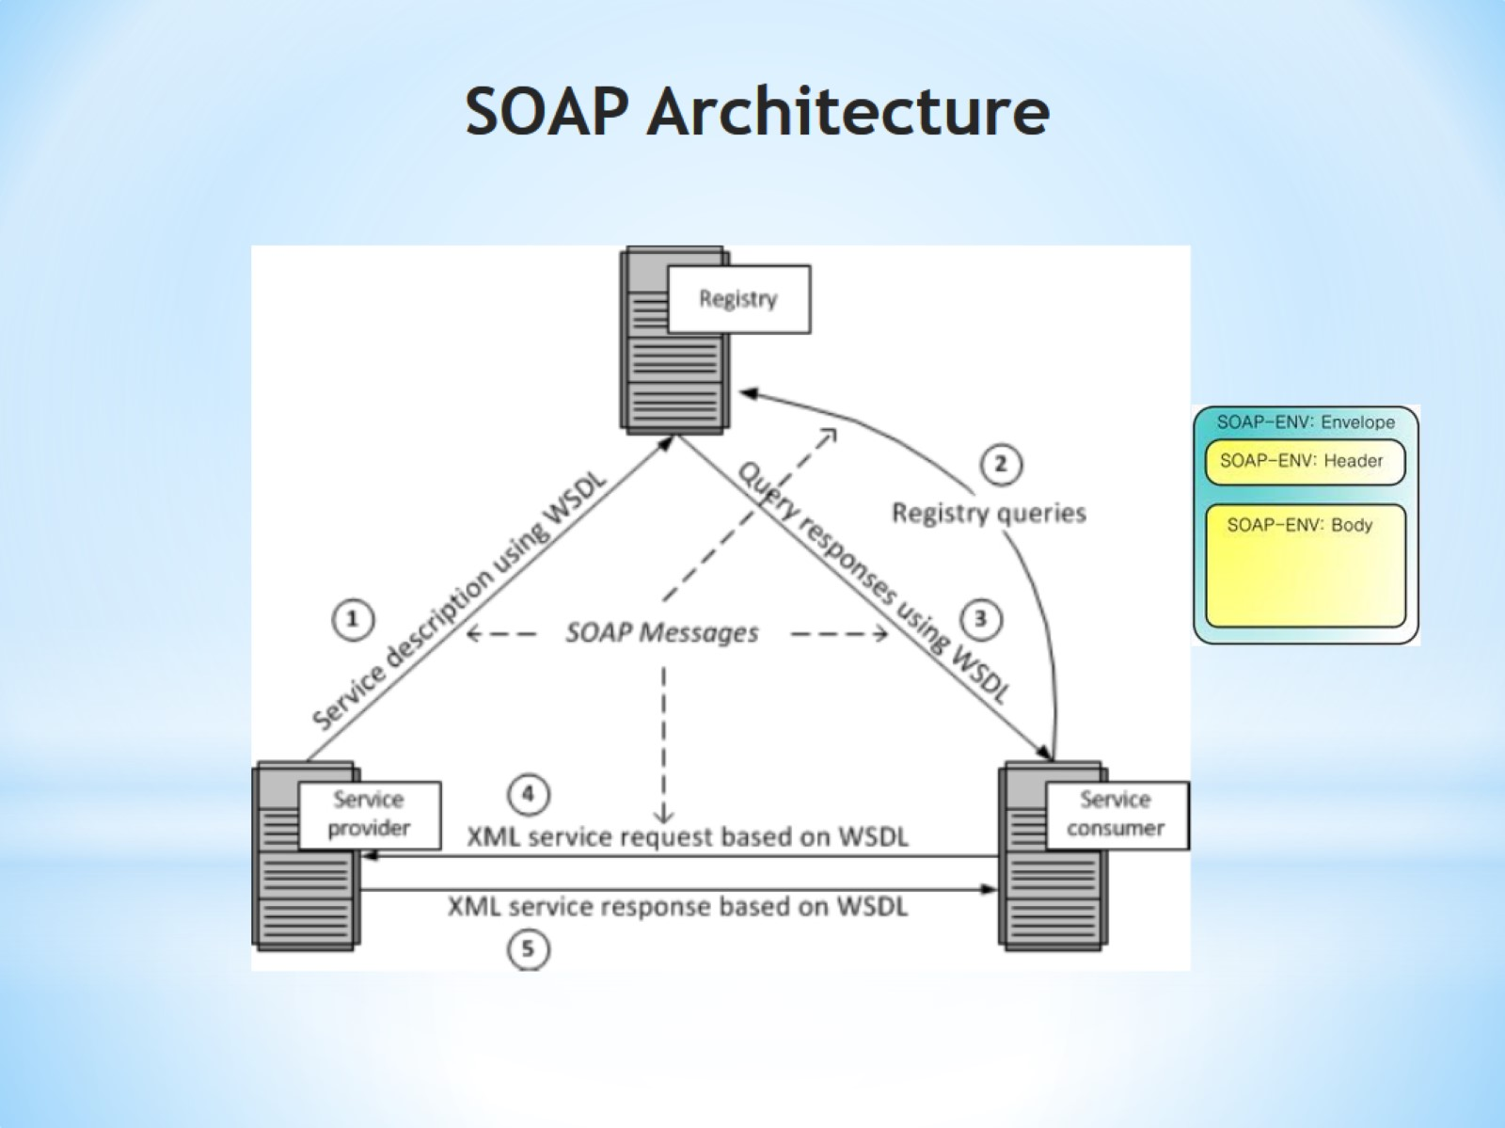
SOAP Architecture

Slide 14
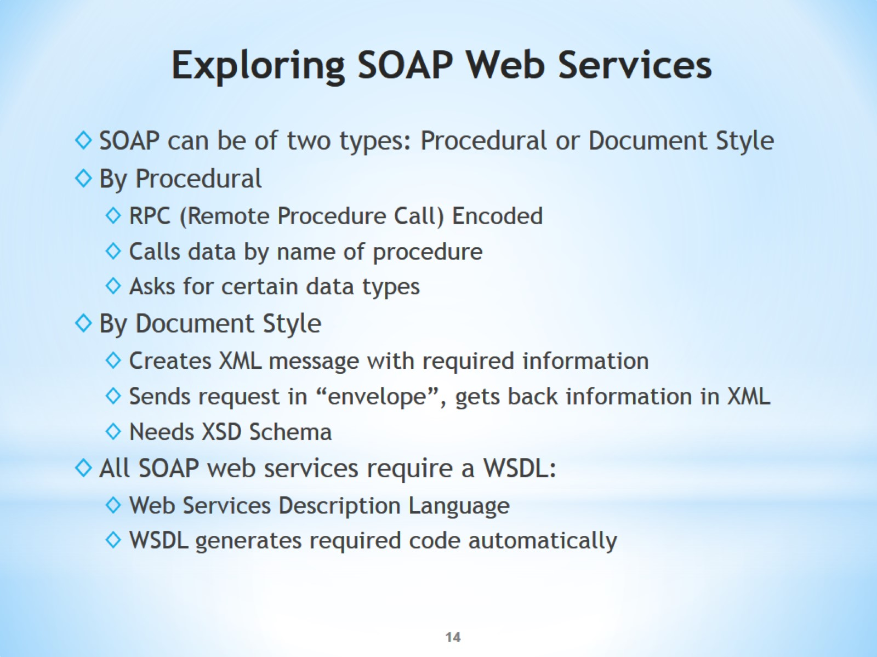
Exploring SOAP Web Services

Slide 15
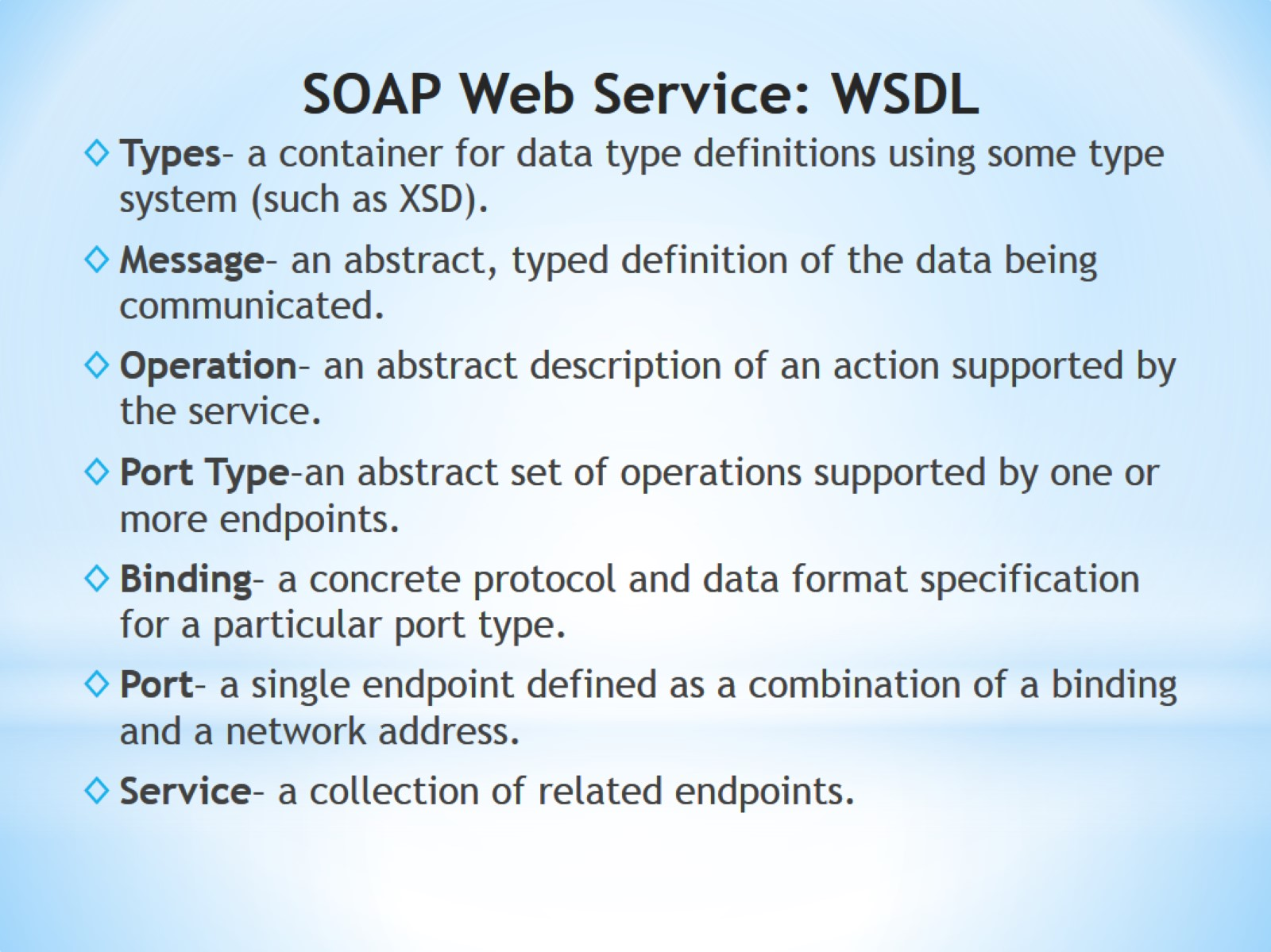
SOAP Web Service: WSDL

Slide 16
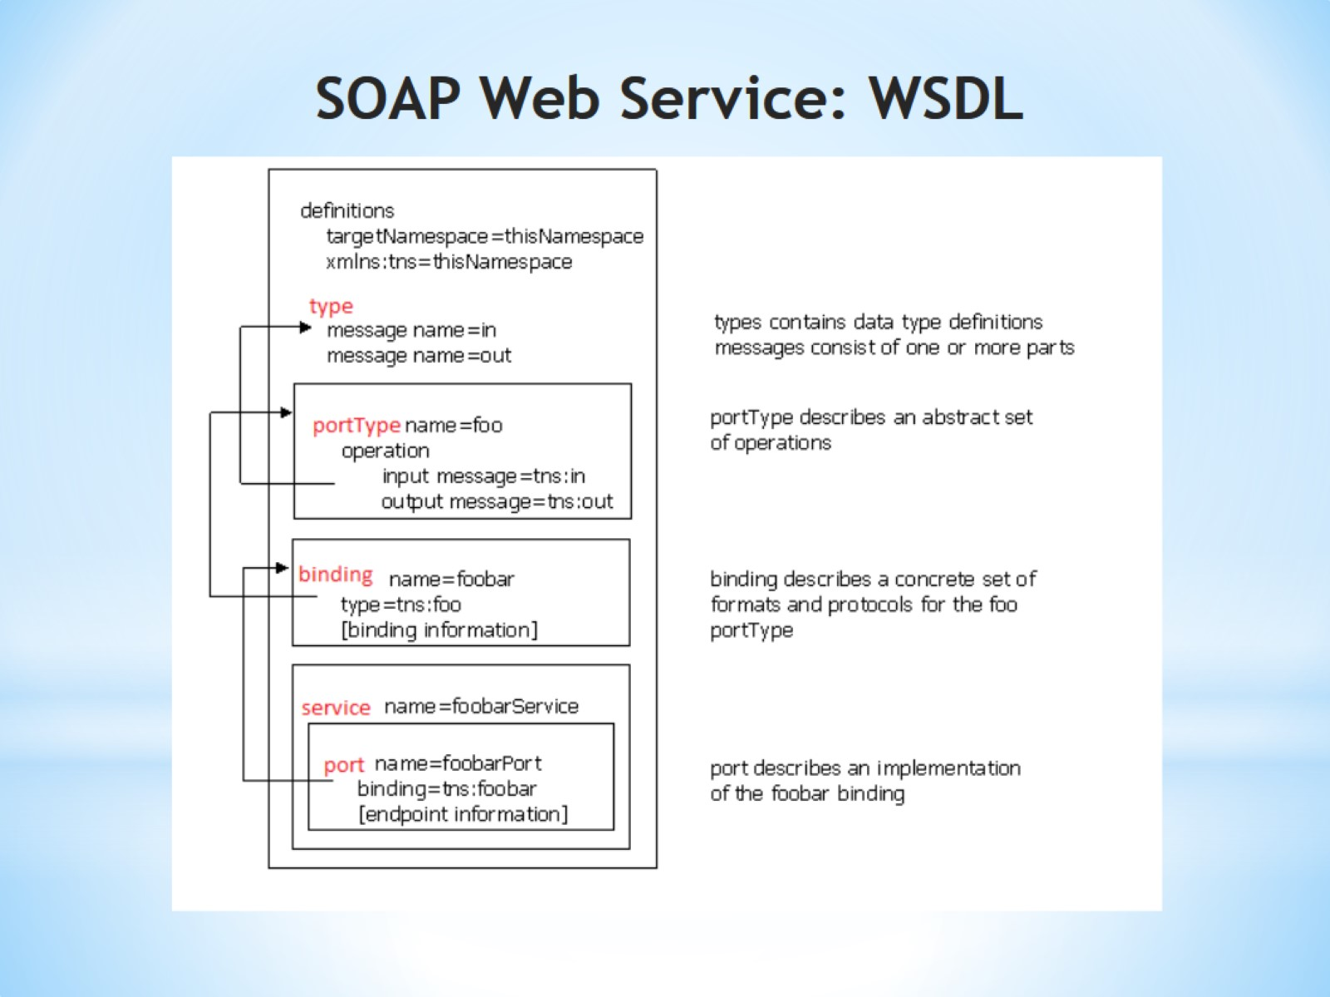
SOAP Web Service: WSDL

Slide 17
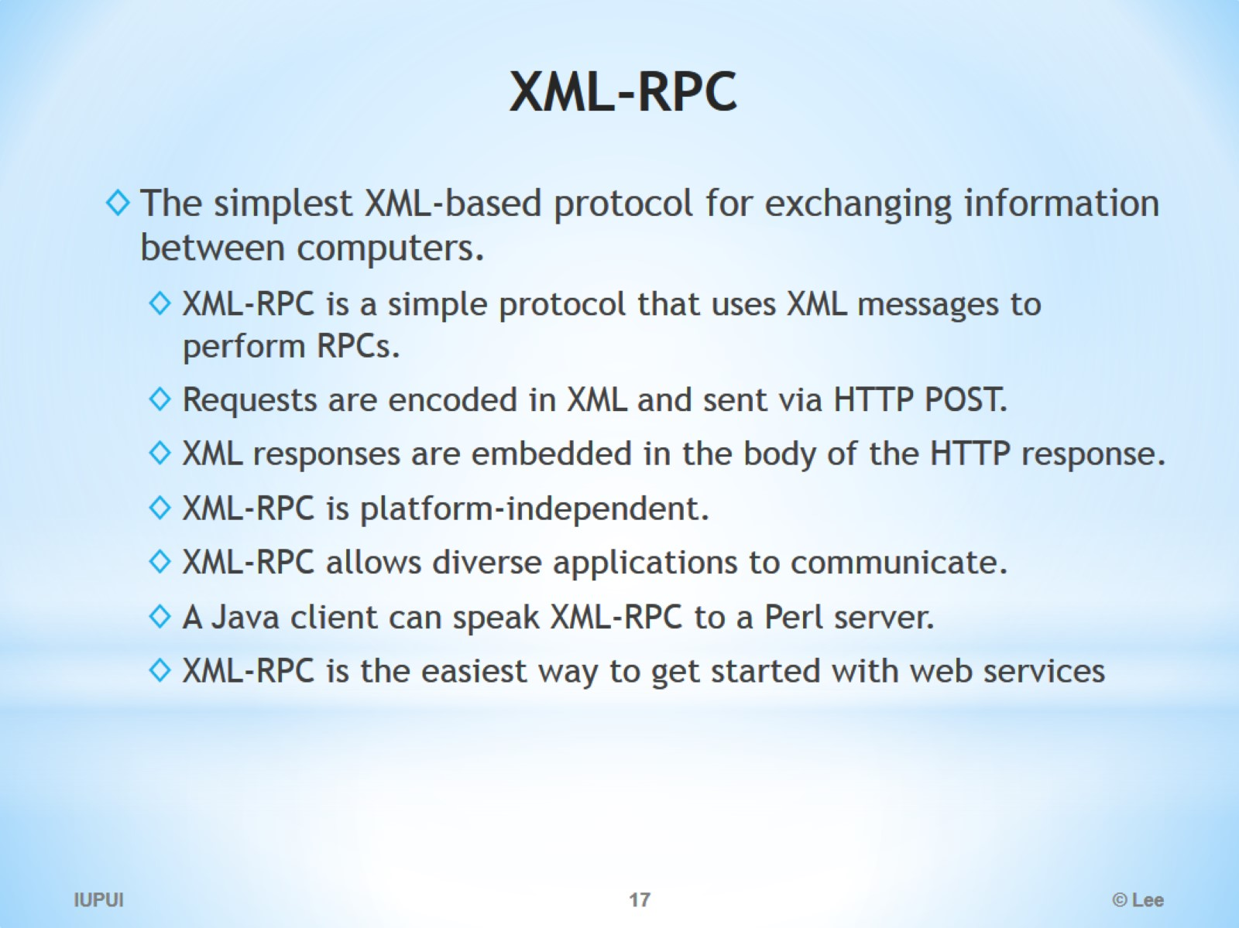
XML-RPC

Slide 18
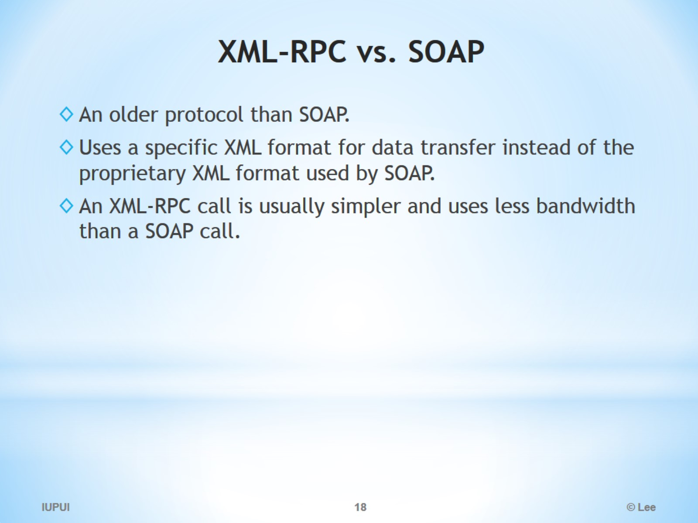
XML-RPC vs. SOAP

Slide 19
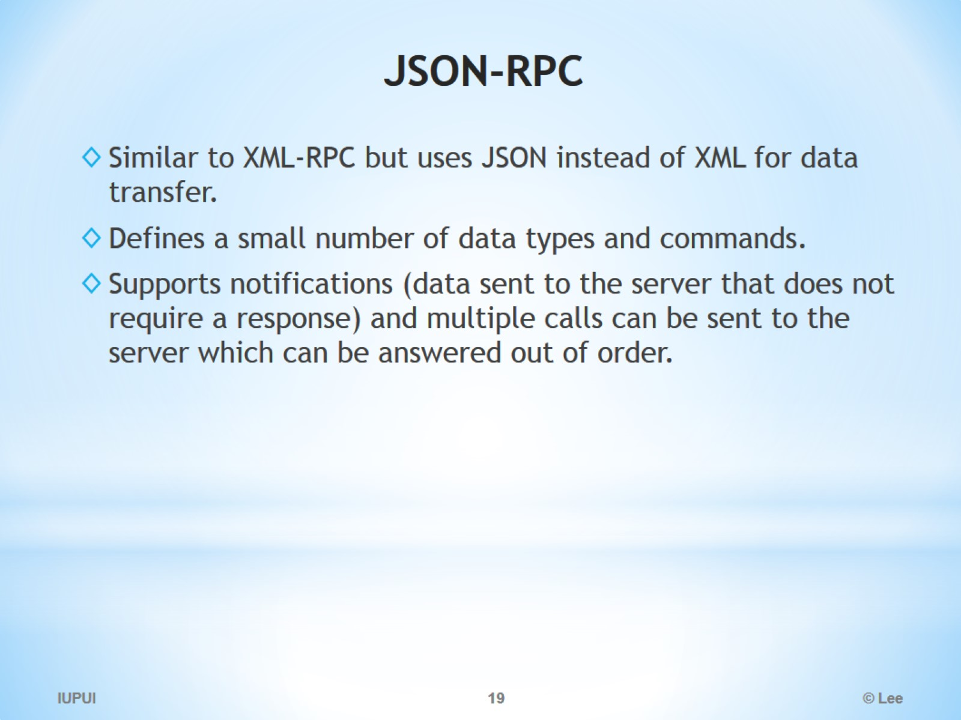
JSON-RPC

Slide 20
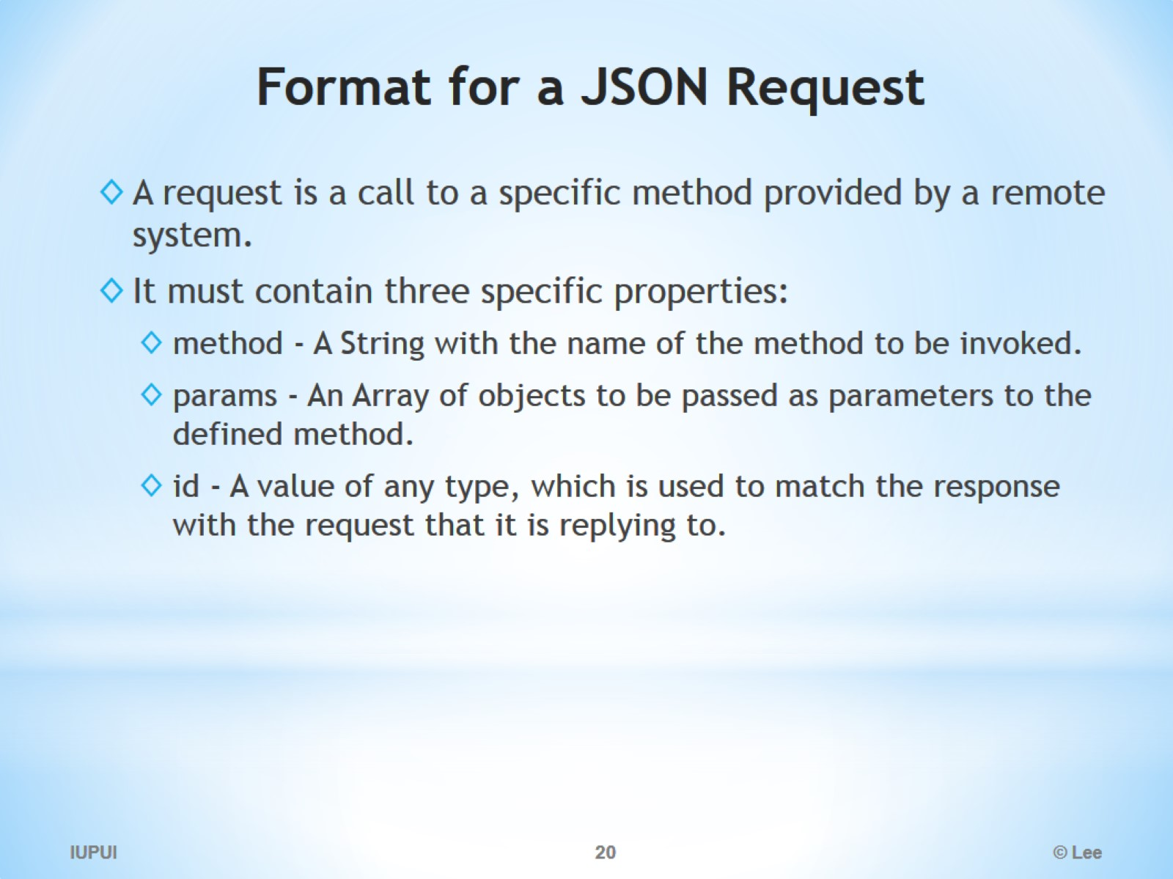
Format for a JSON Request

Slide 21
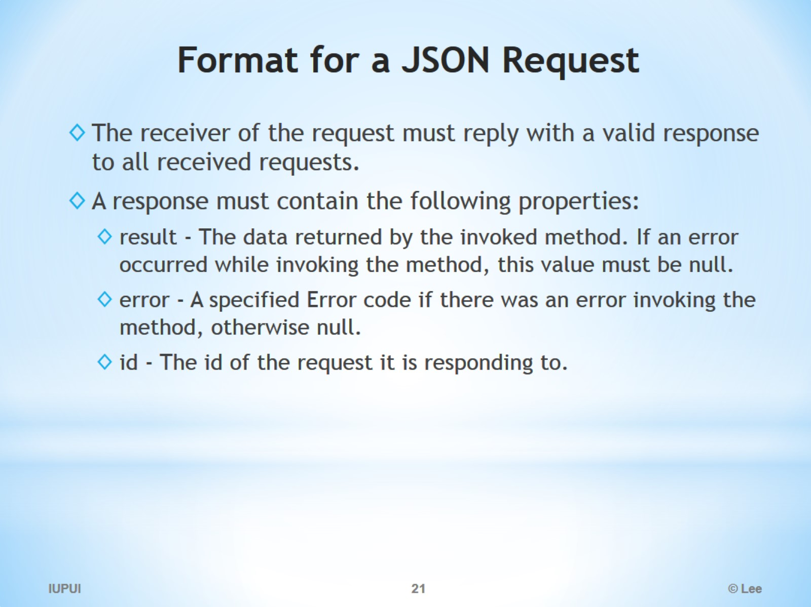
Format for a JSON Request

Slide 22
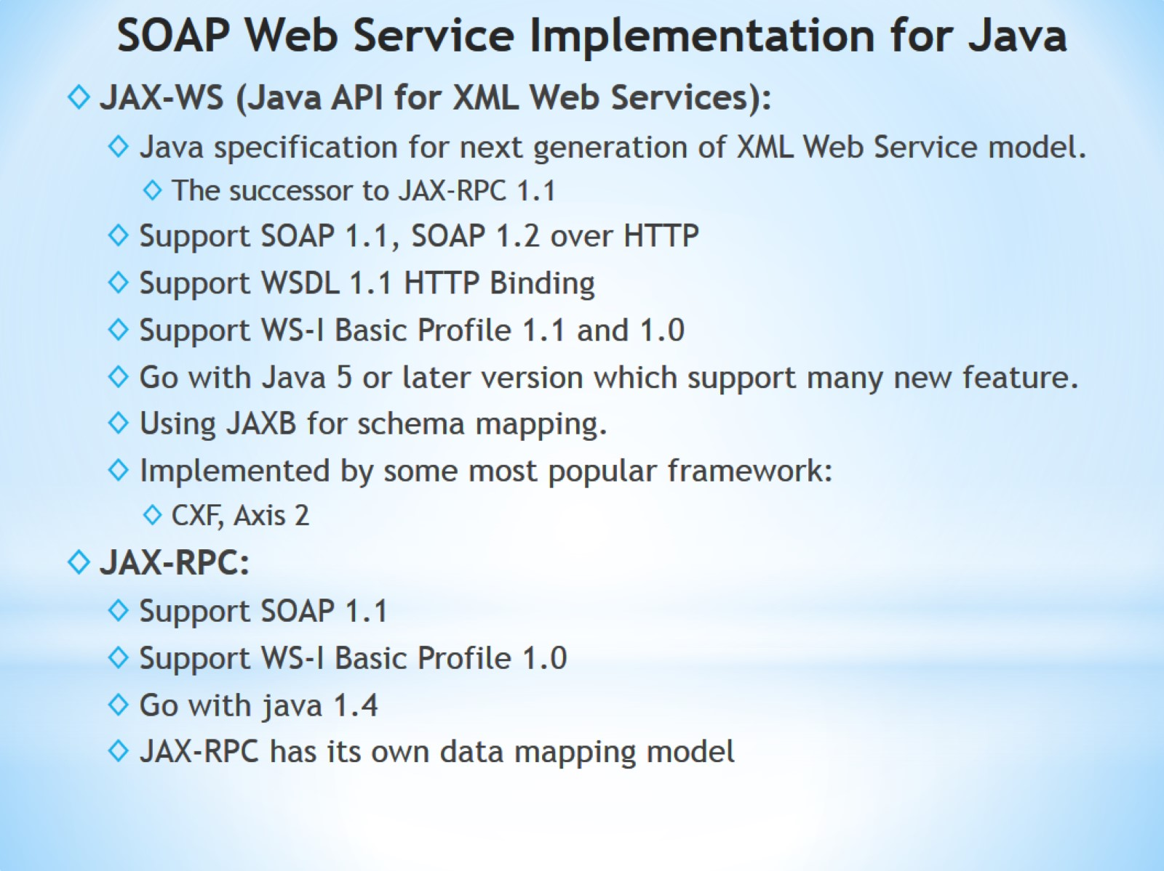
SOAP Web Service Implementation for Java

Slide 23
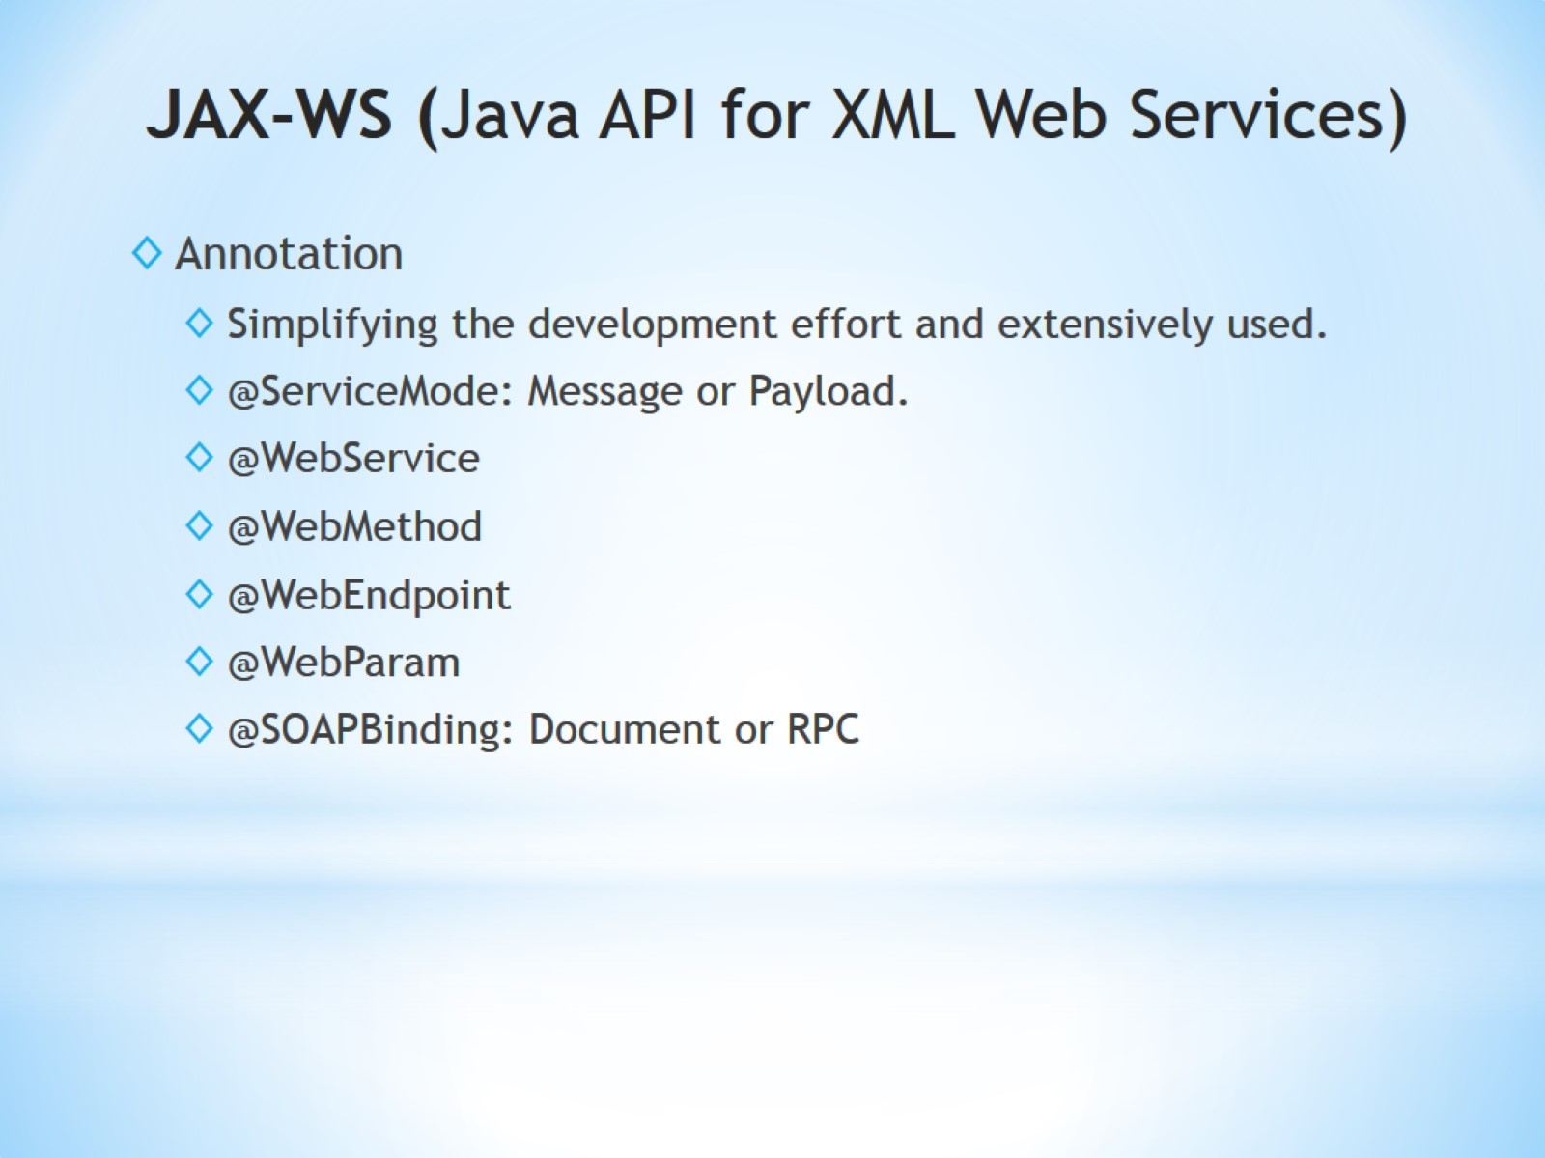
JAX-WS (Java API for XML Web Services)

Slide 24
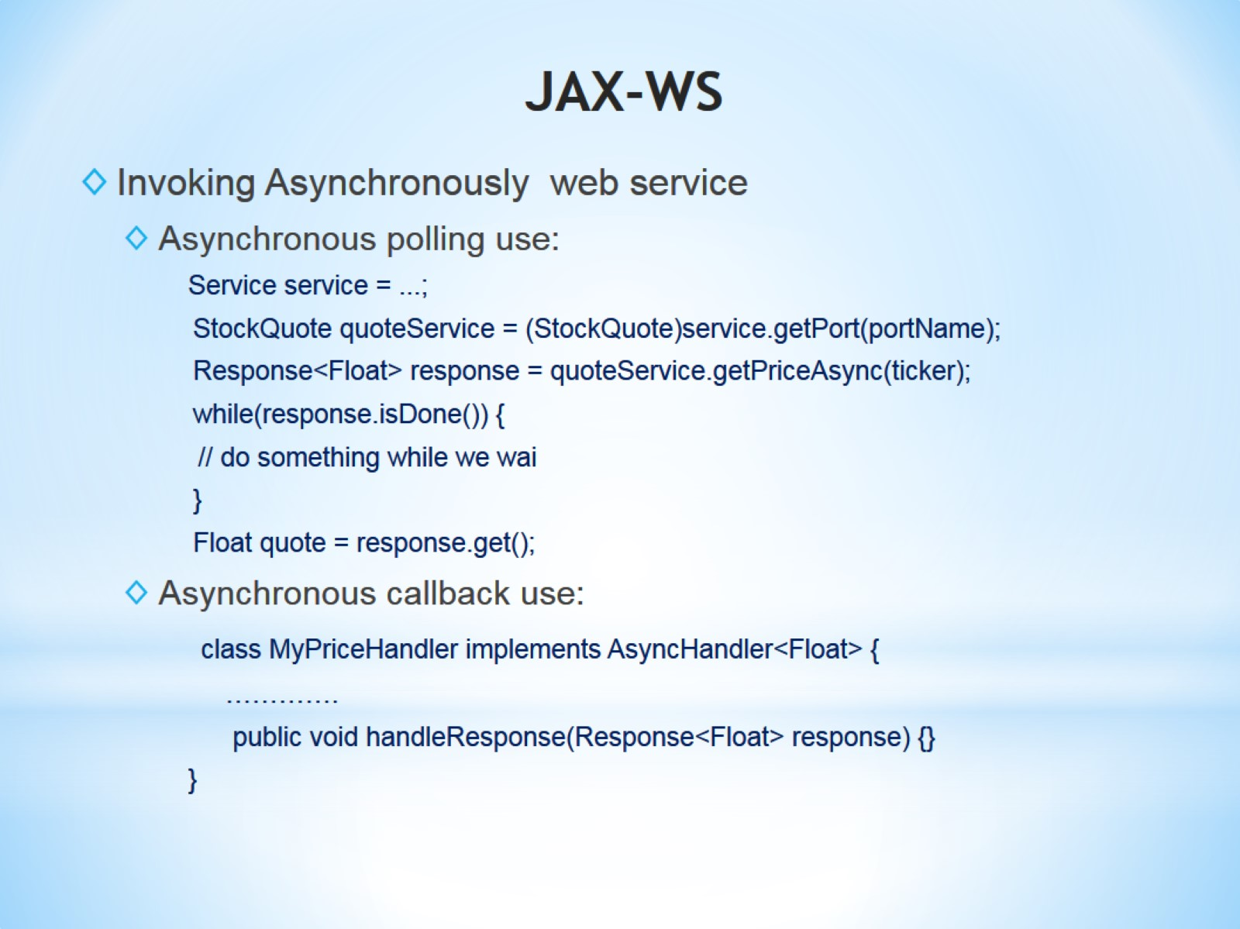
JAX-WS

Slide 25
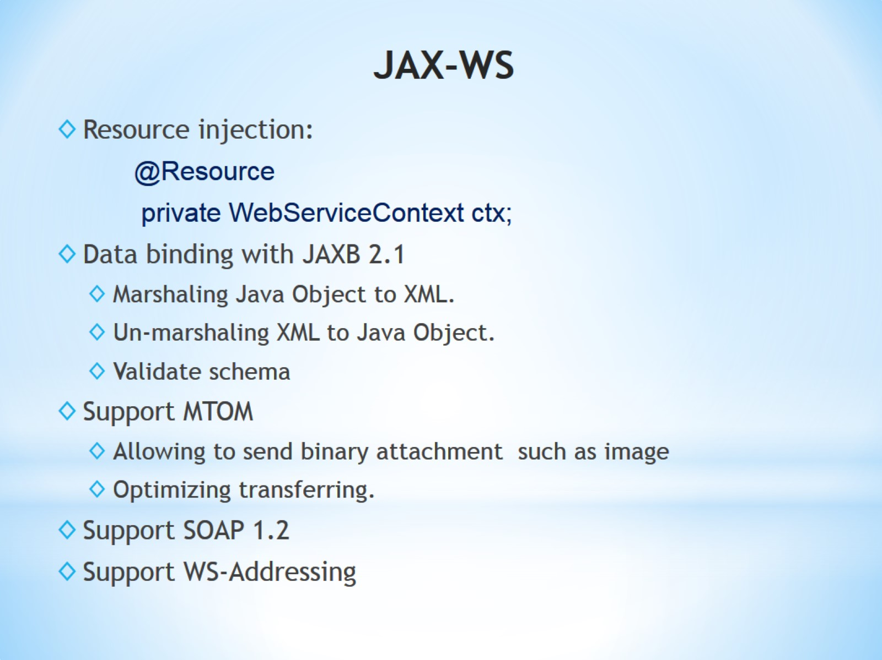
JAX-WS

Slide 26
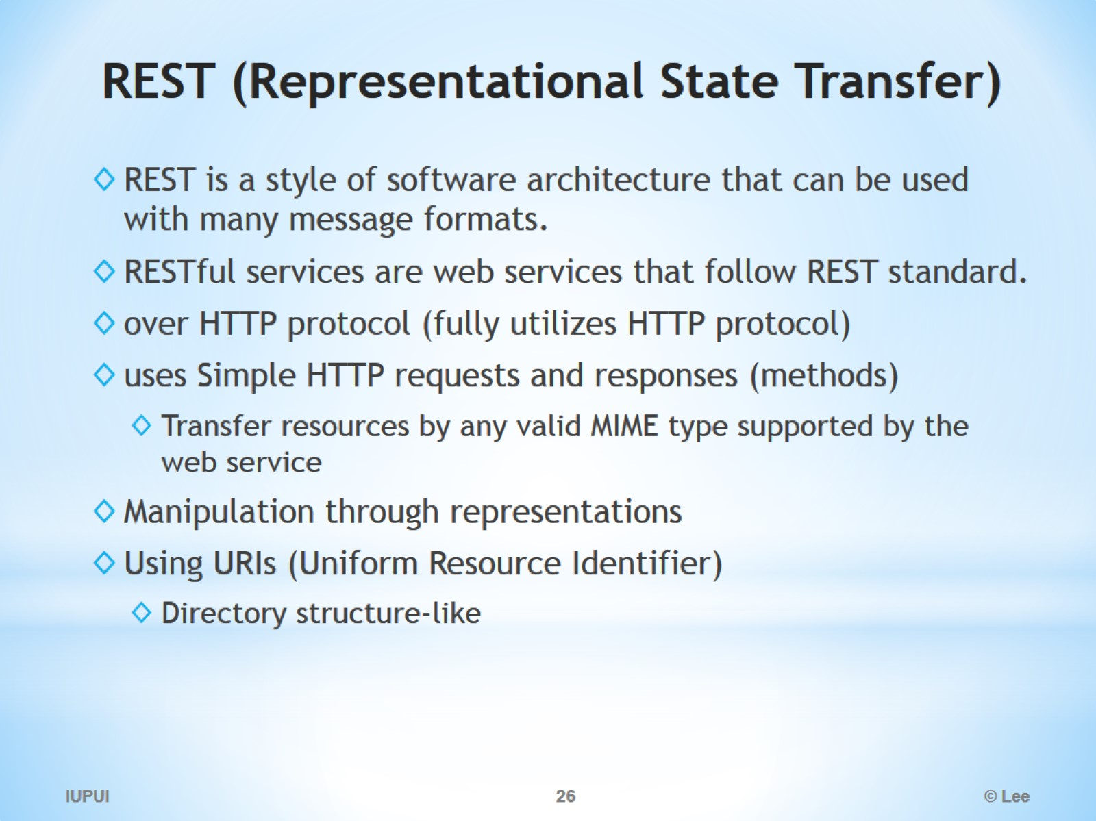
REST (Representational State Transfer)

Slide 27
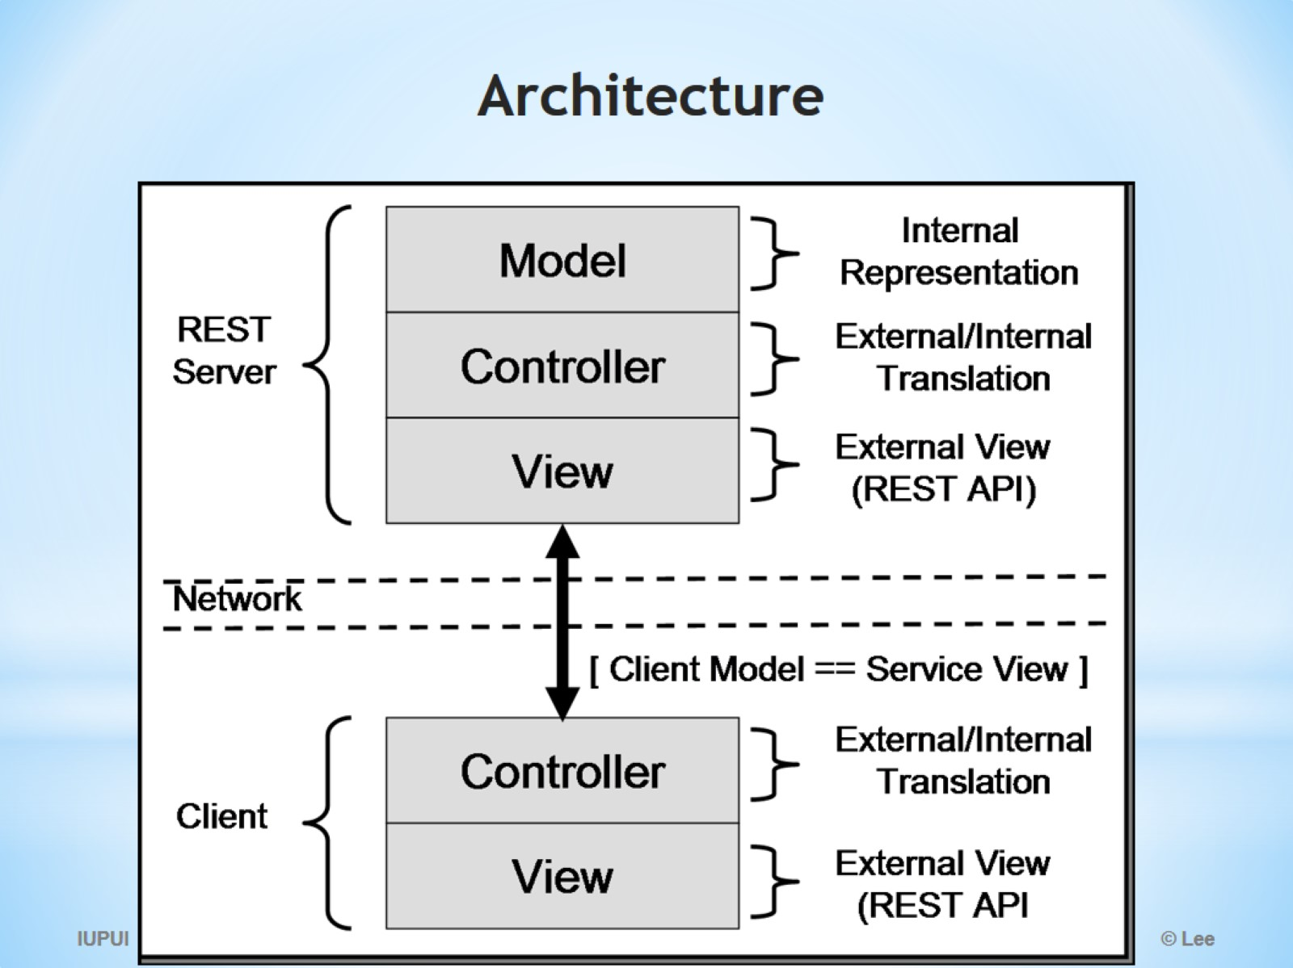
Architecture

Slide 28
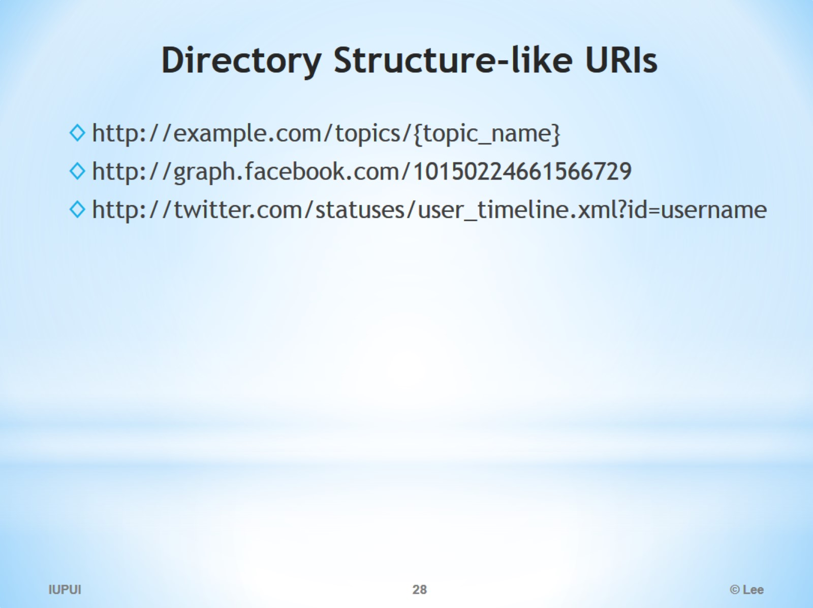
Directory Structure­-like URIs

Slide 29
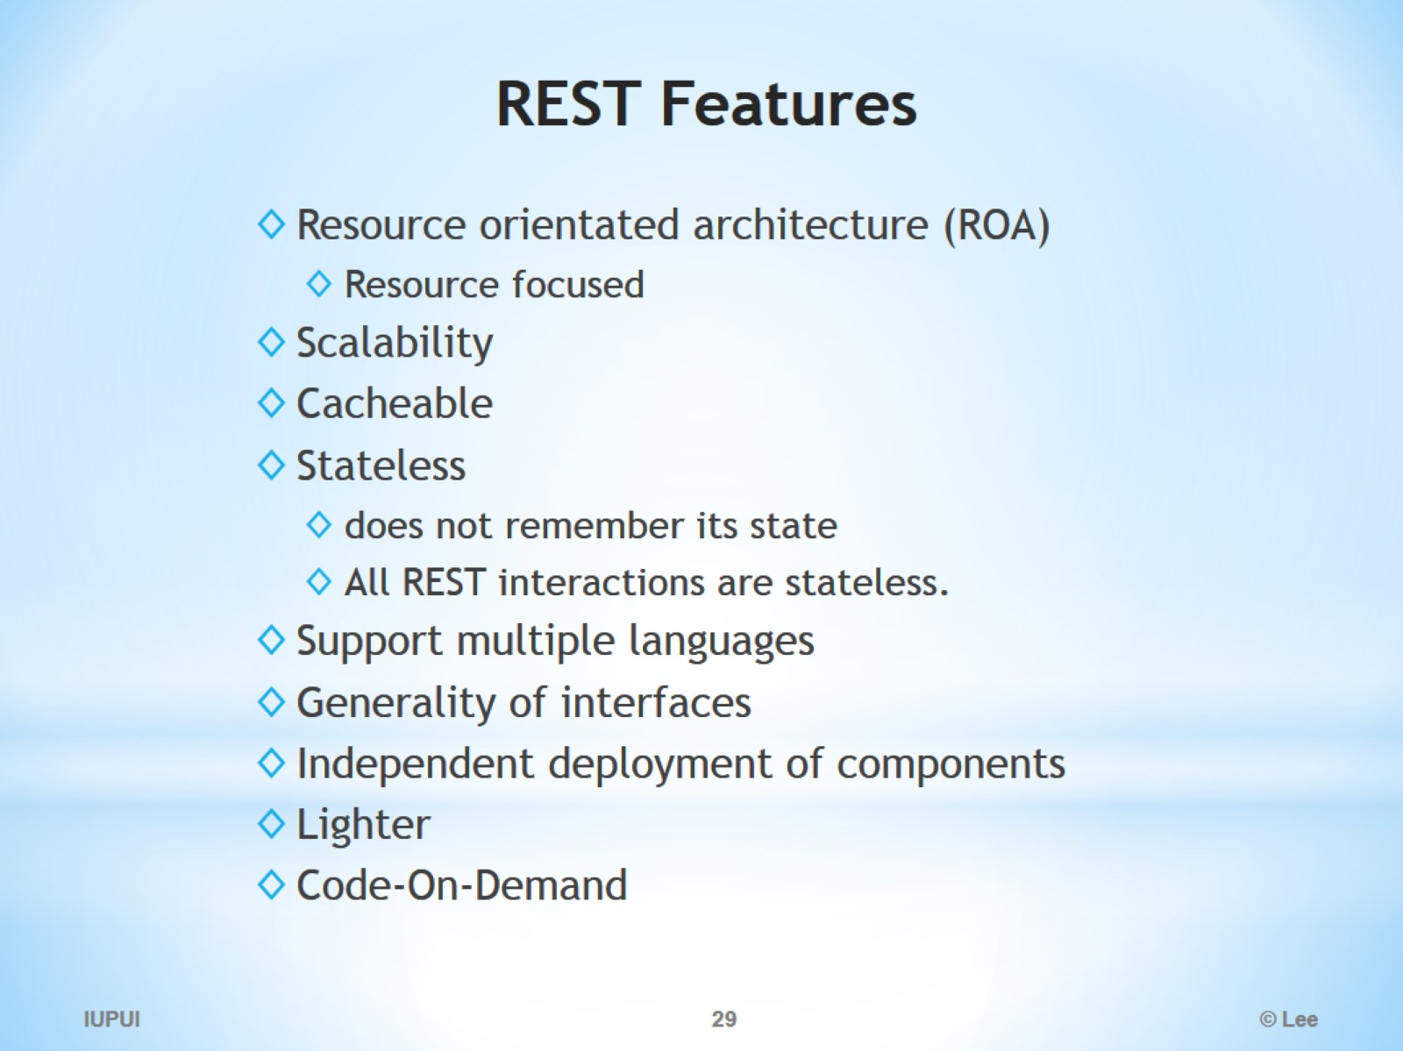
REST Features

Slide 30
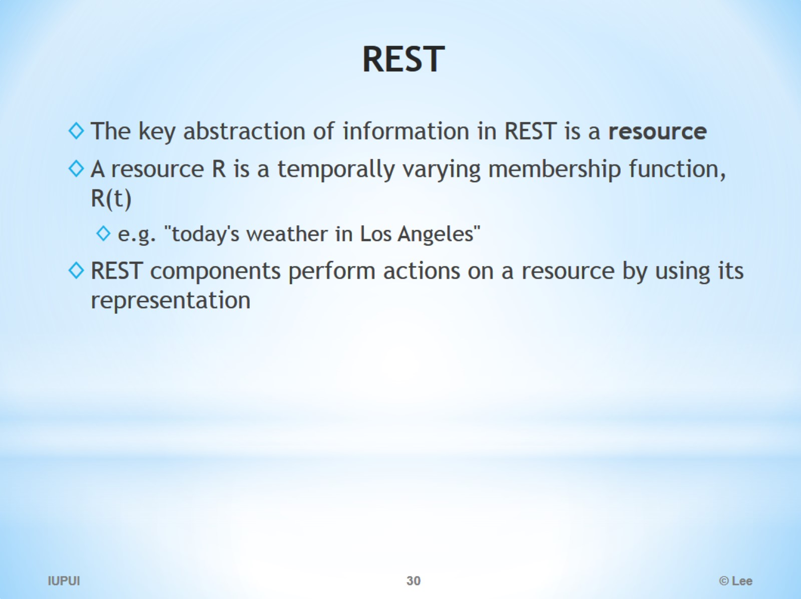
REST

Slide 31
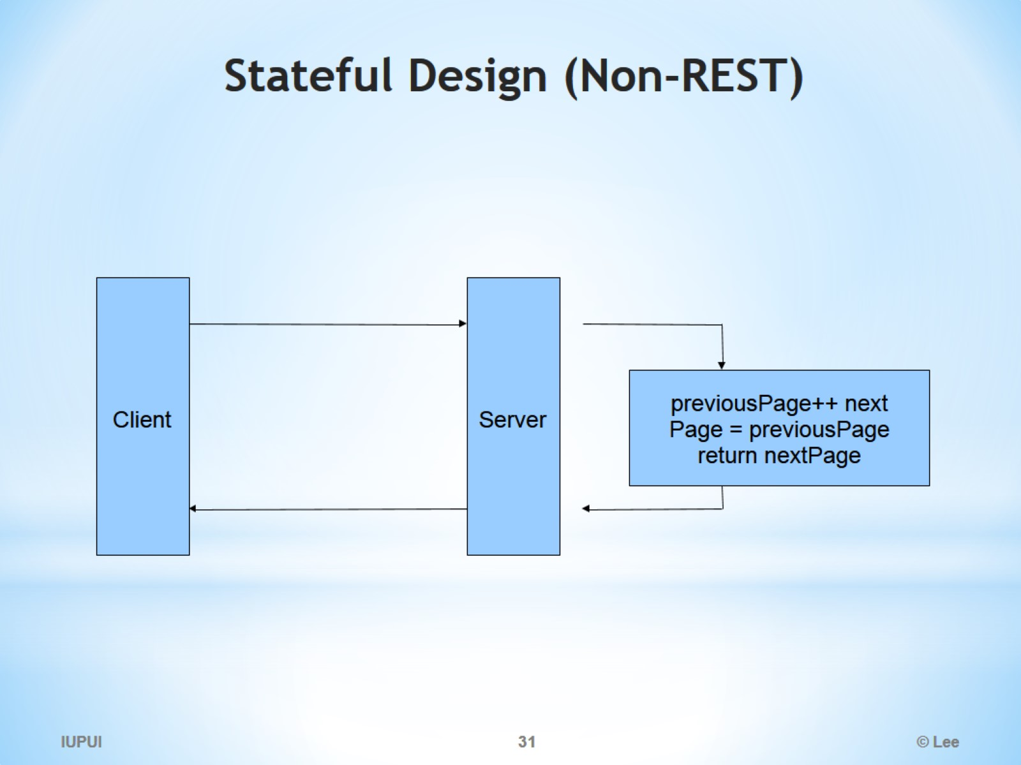
Stateful Design (Non-REST)

Slide 32
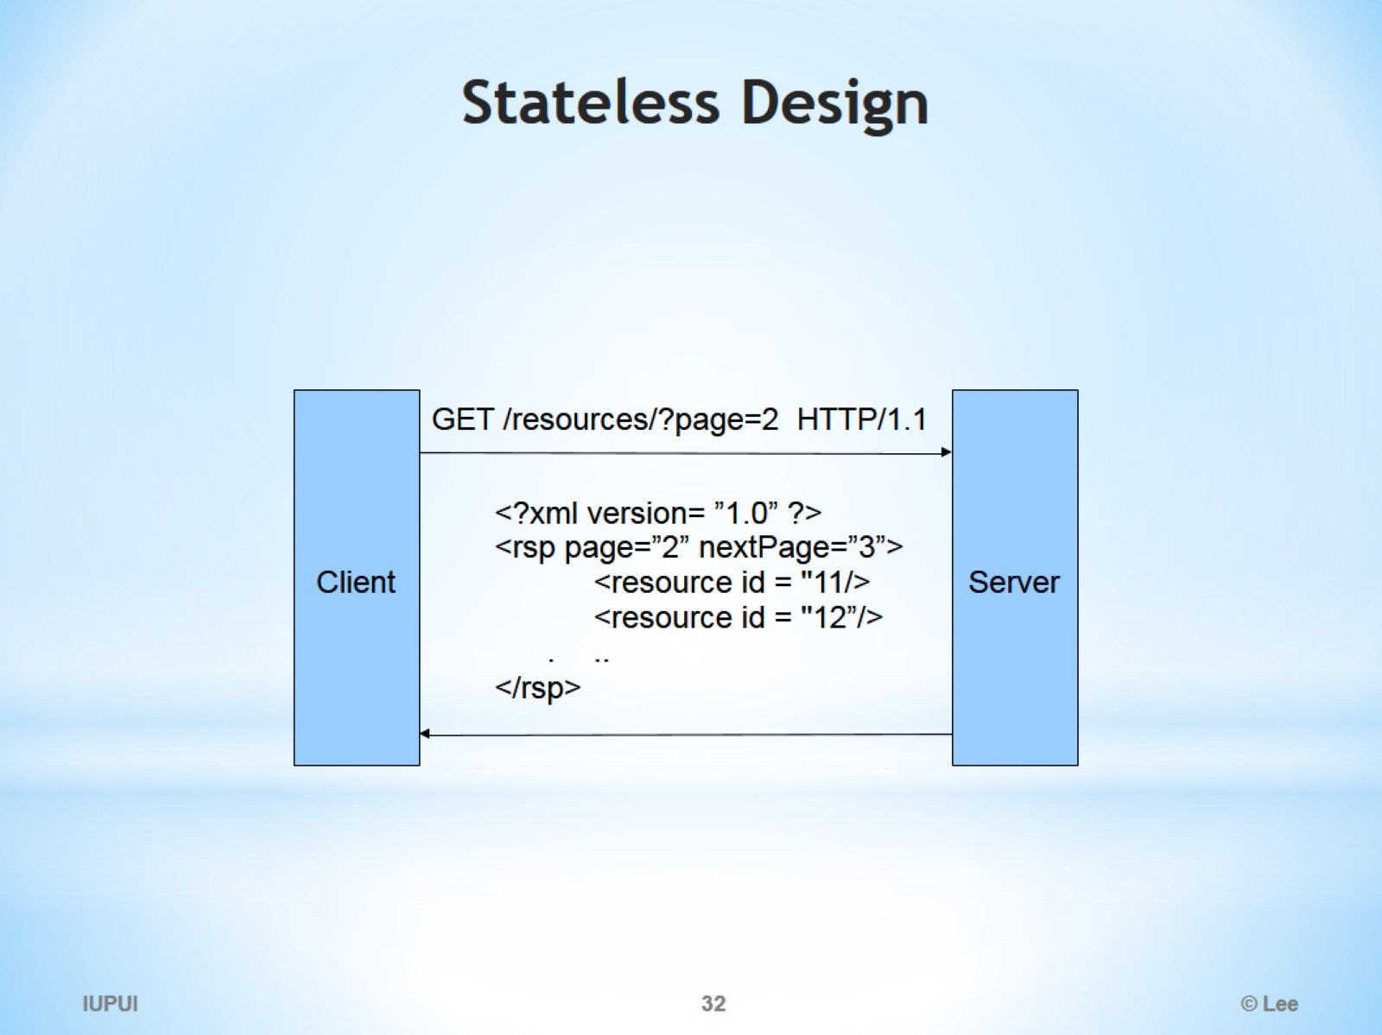
Stateless Design

Slide 33
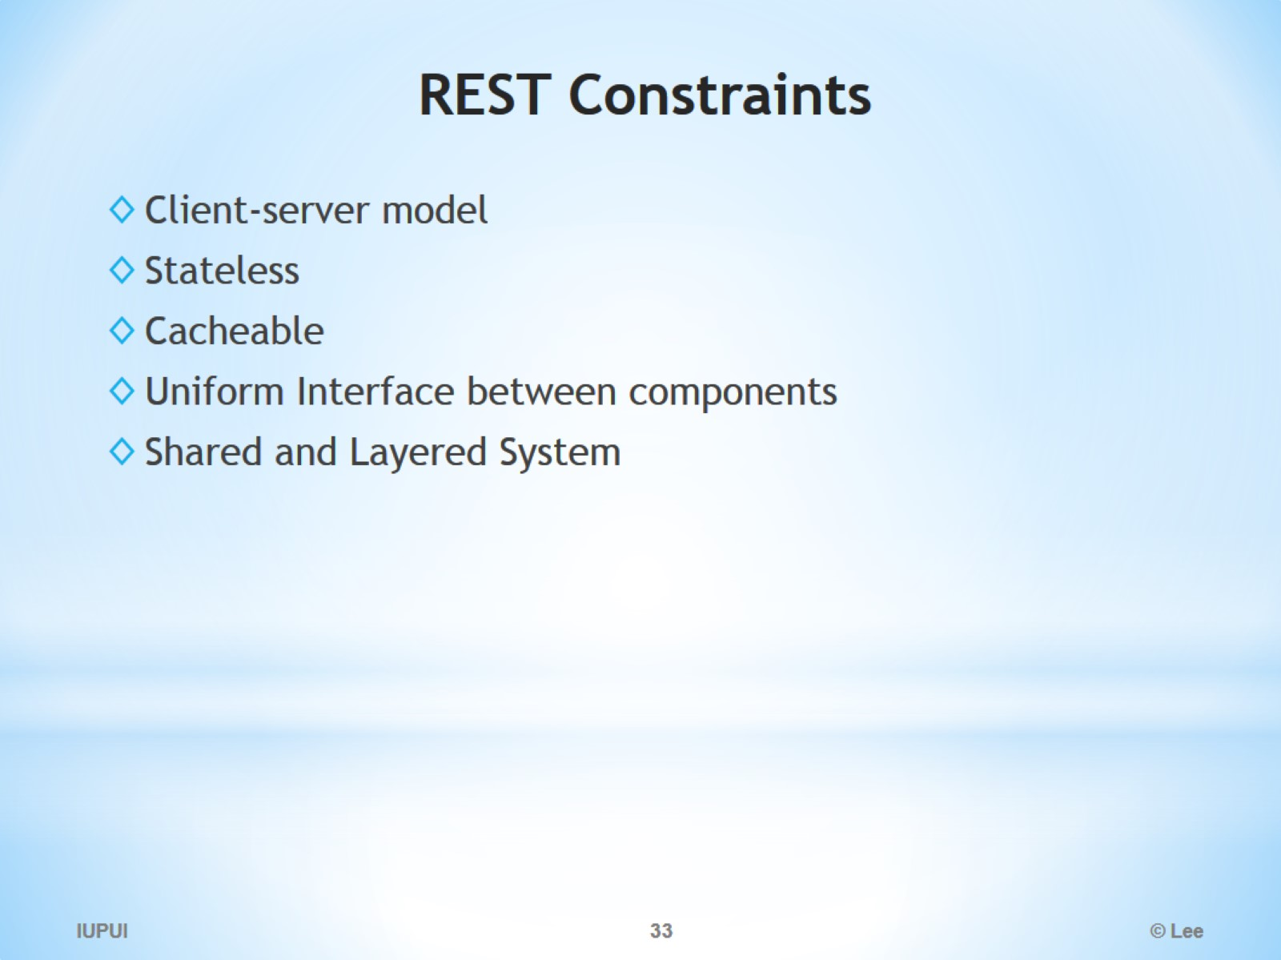
REST Constraints

Slide 34
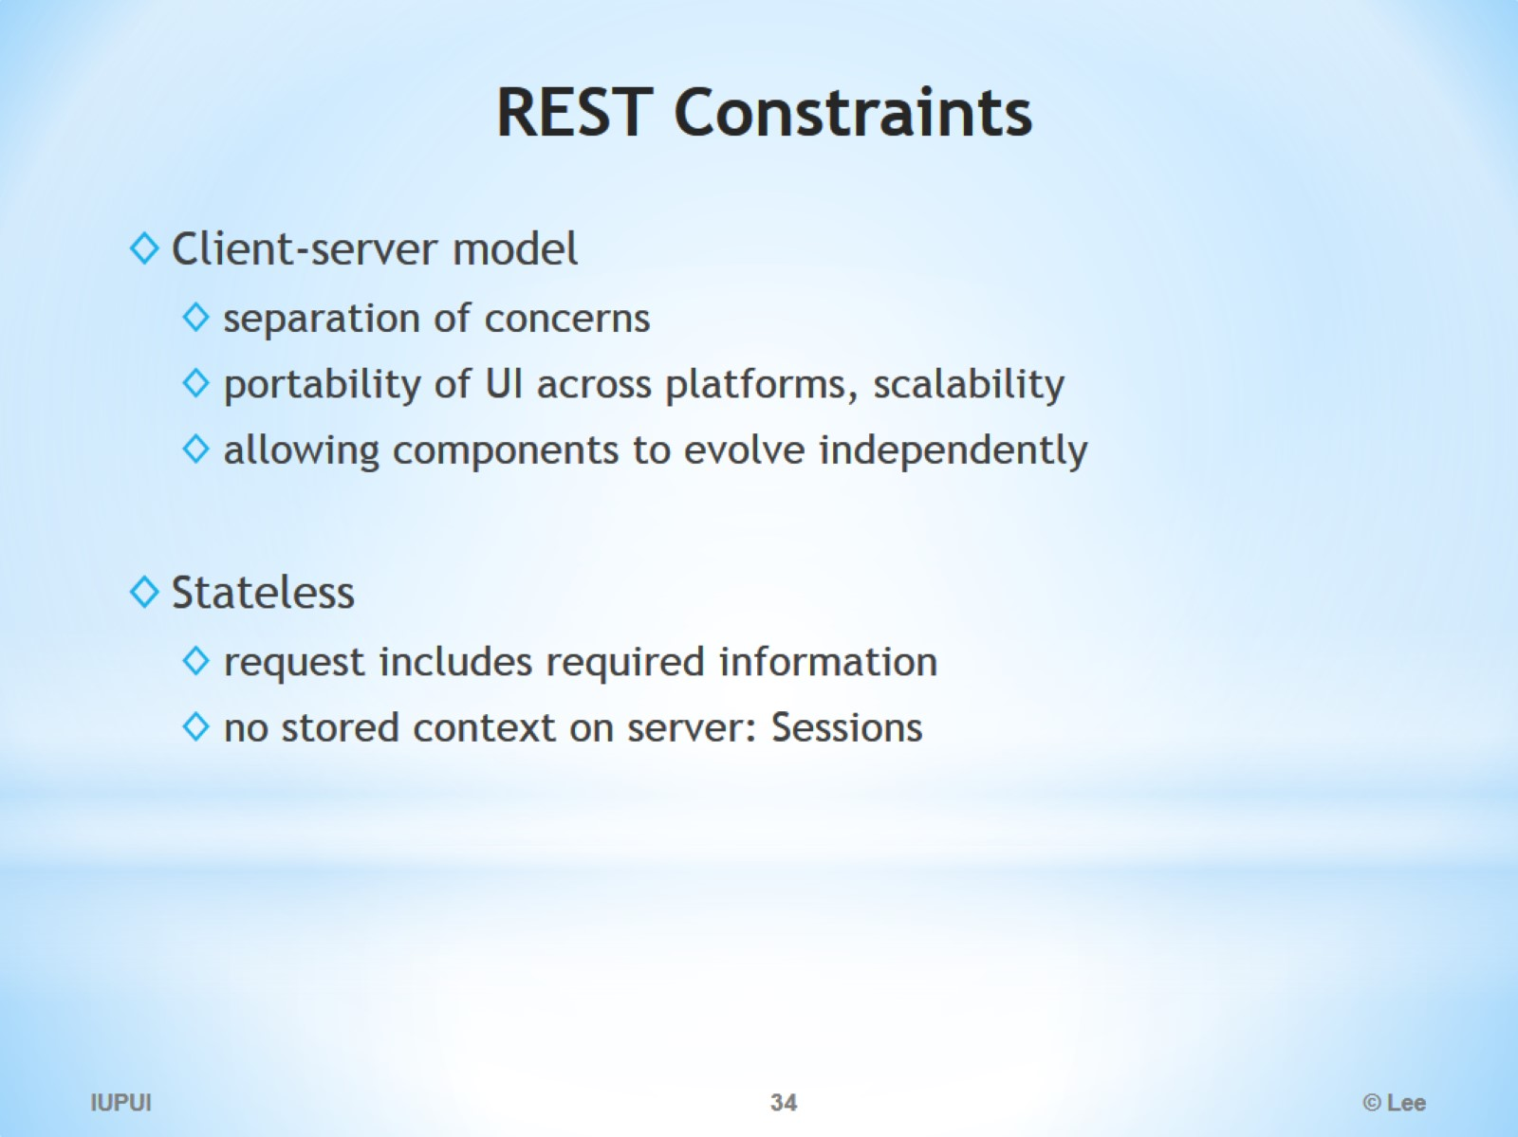
REST Constraints

Slide 35
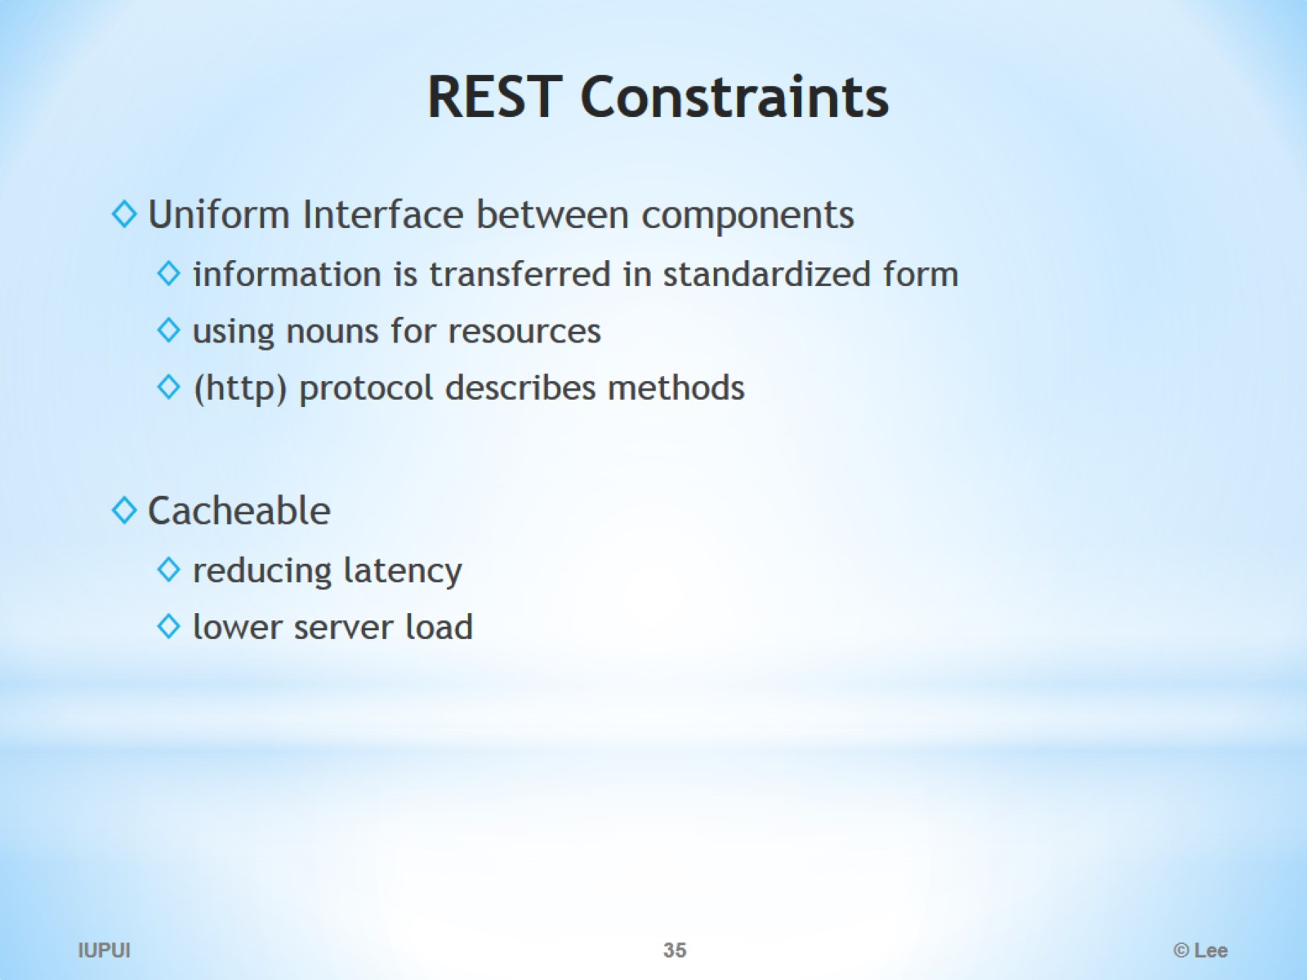
REST Constraints

Slide 36
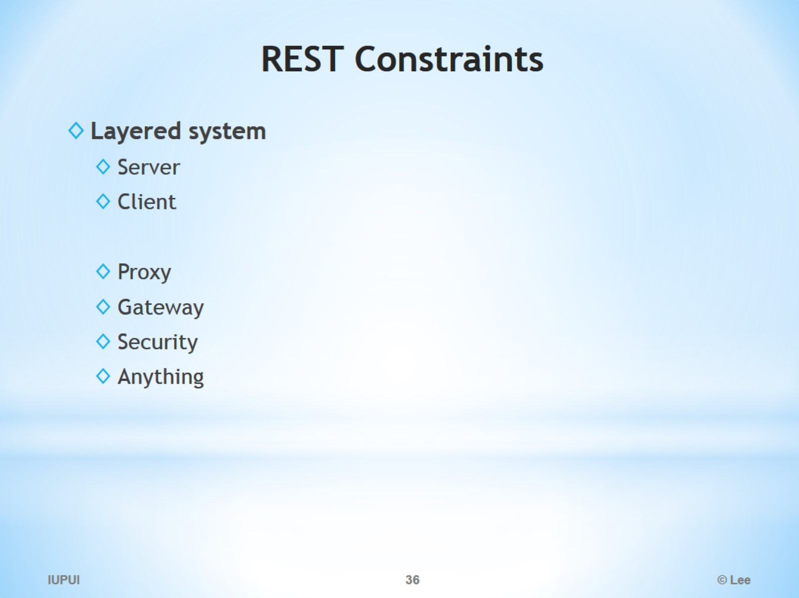
REST Constraints

Slide 37
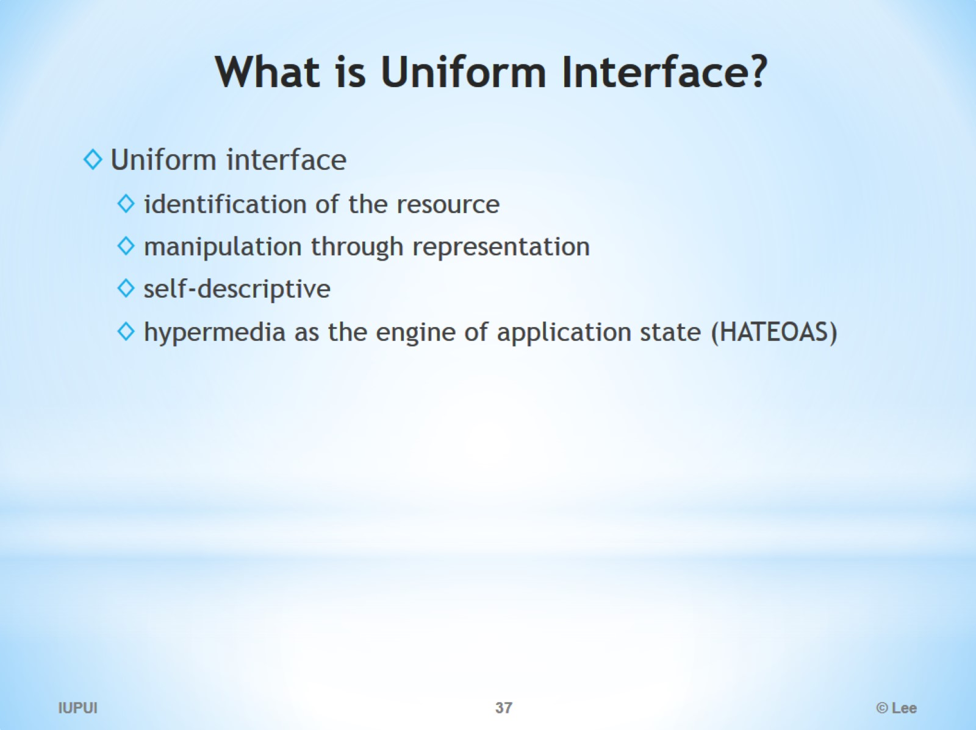
What is Uniform Interface?

Slide 38
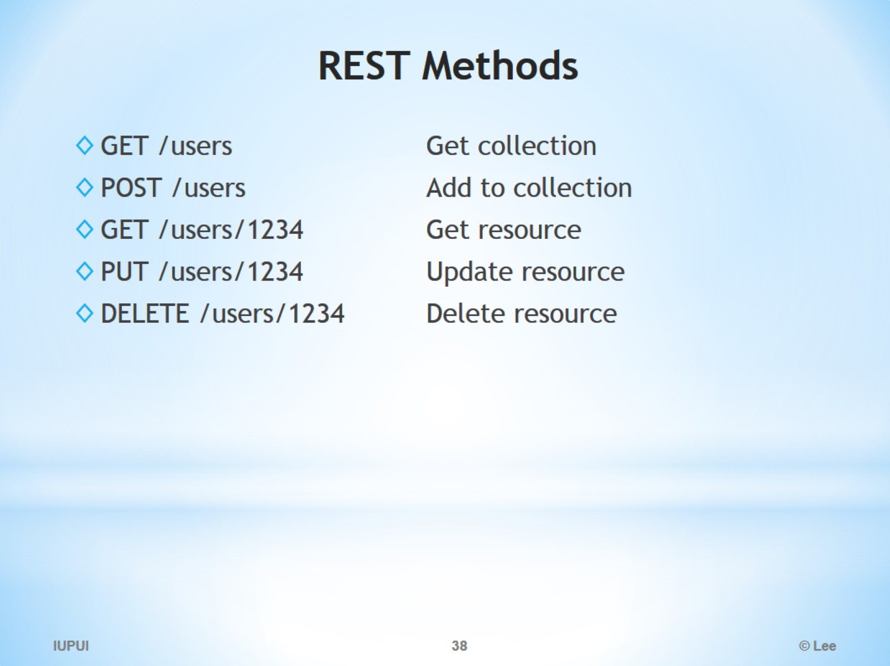
REST Methods

Slide 39
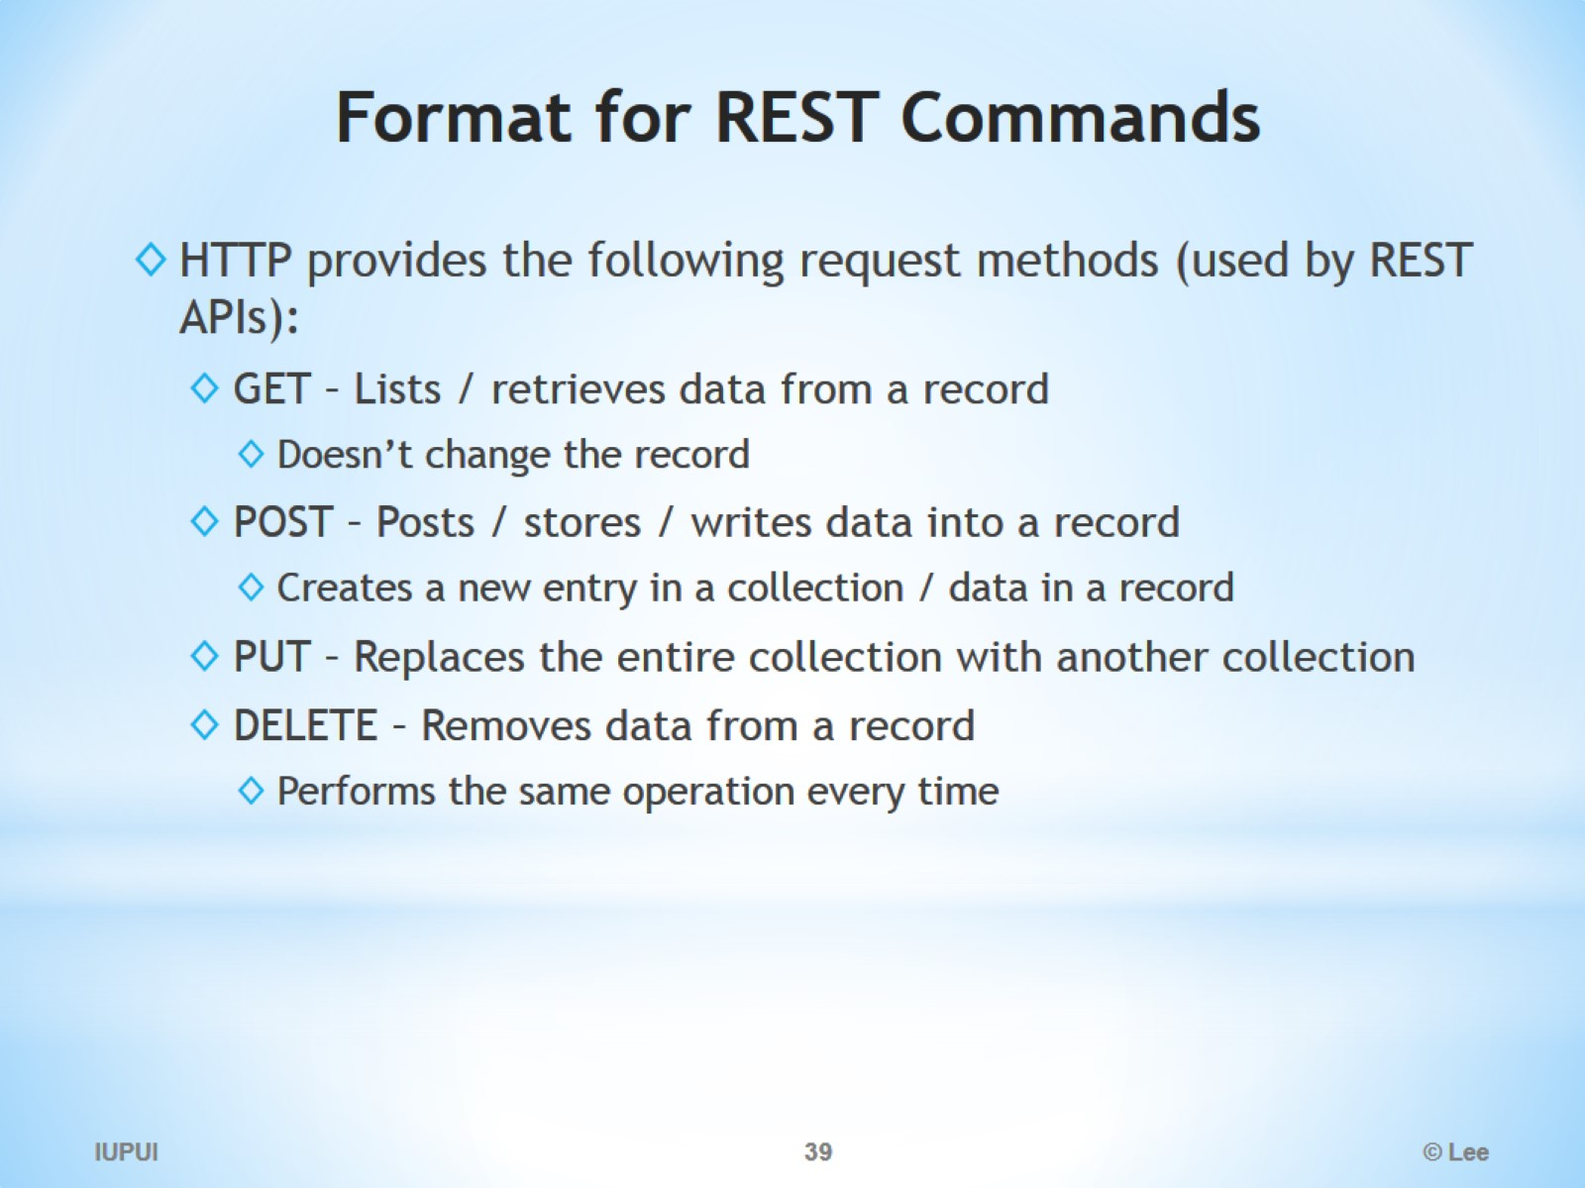
Format for REST Commands

Slide 40
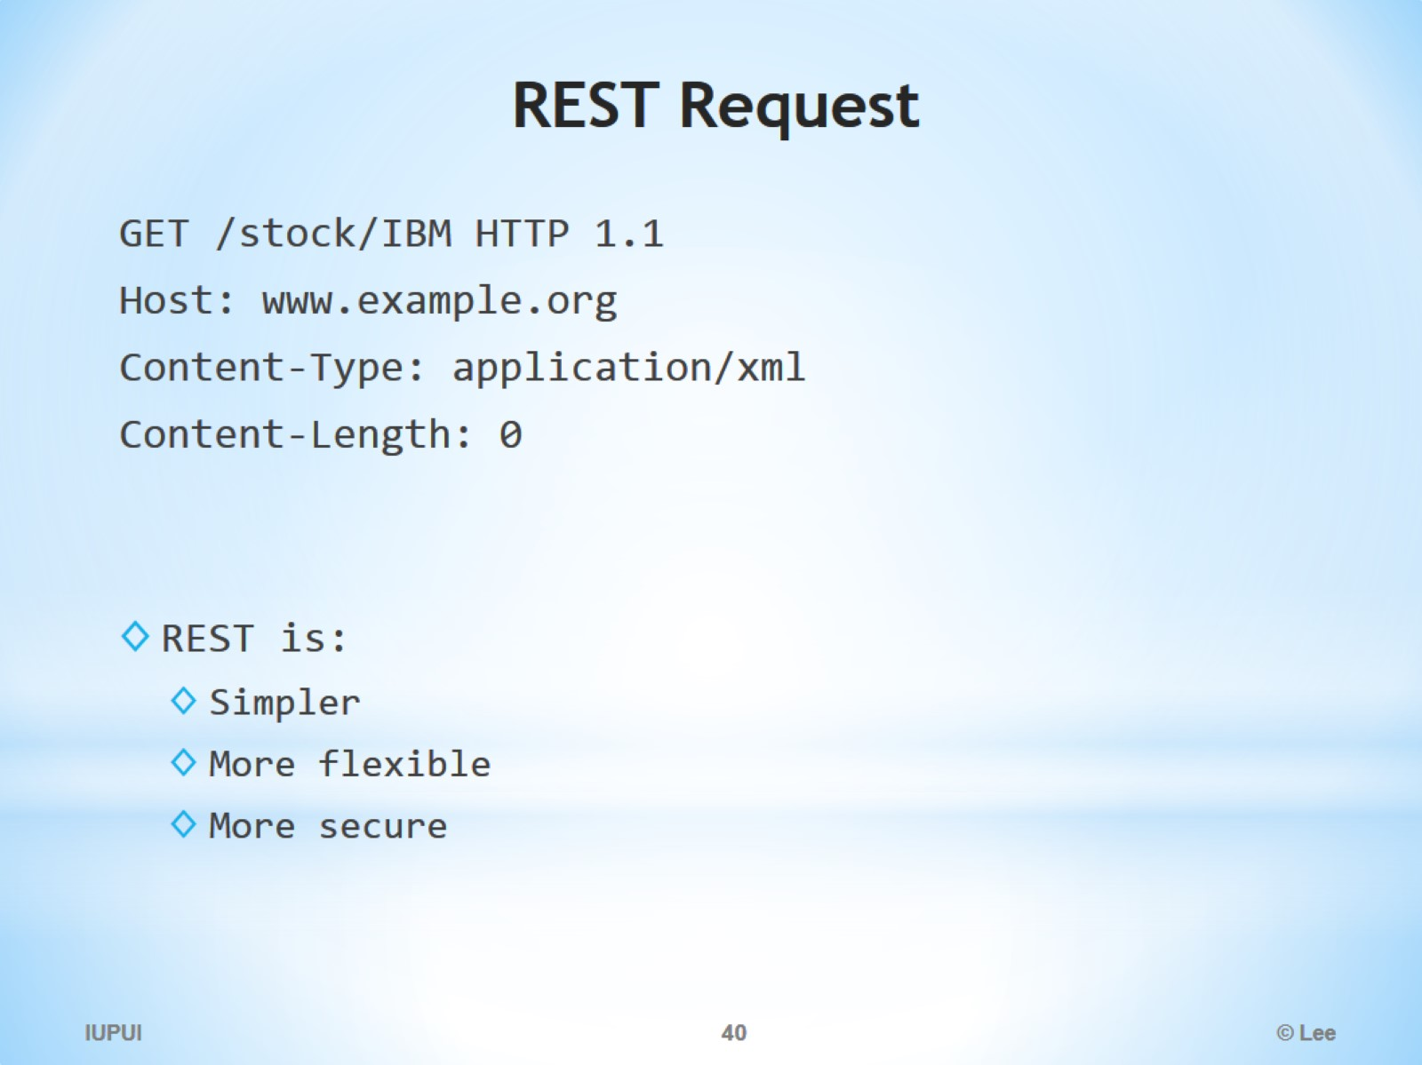
REST Request

Slide 41
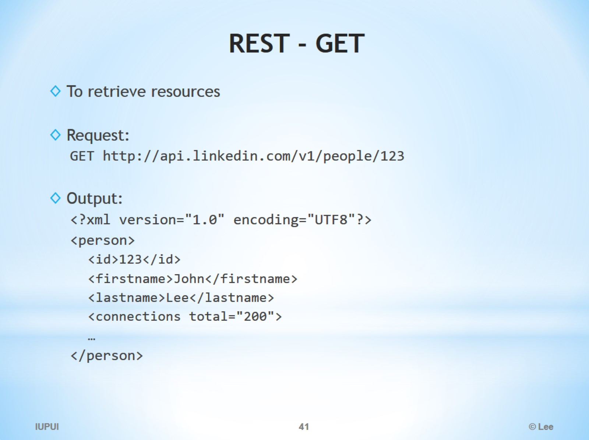
REST - GET

Slide 42
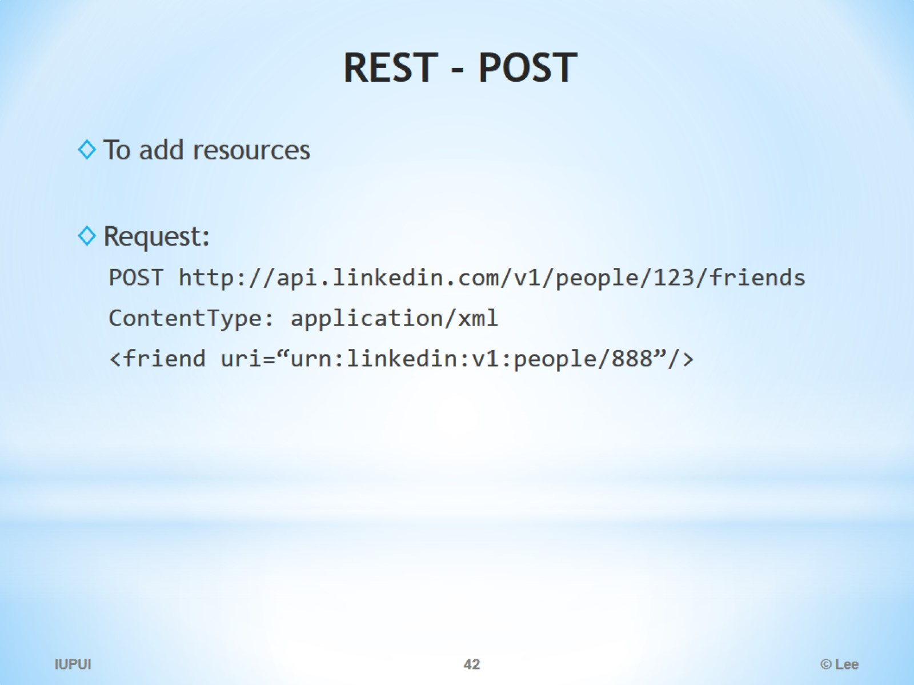
REST - POST

Slide 43
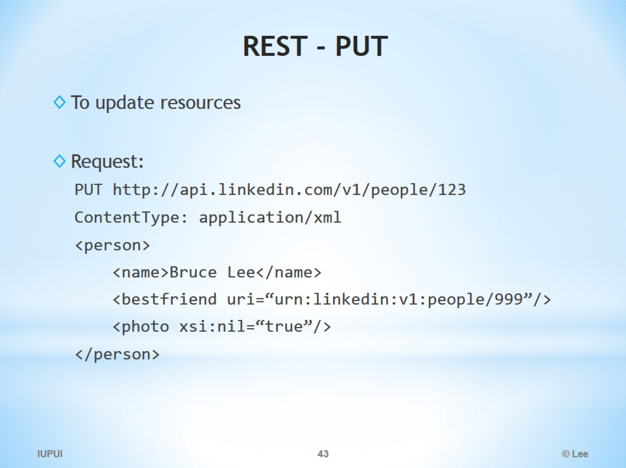
REST - PUT

Slide 44
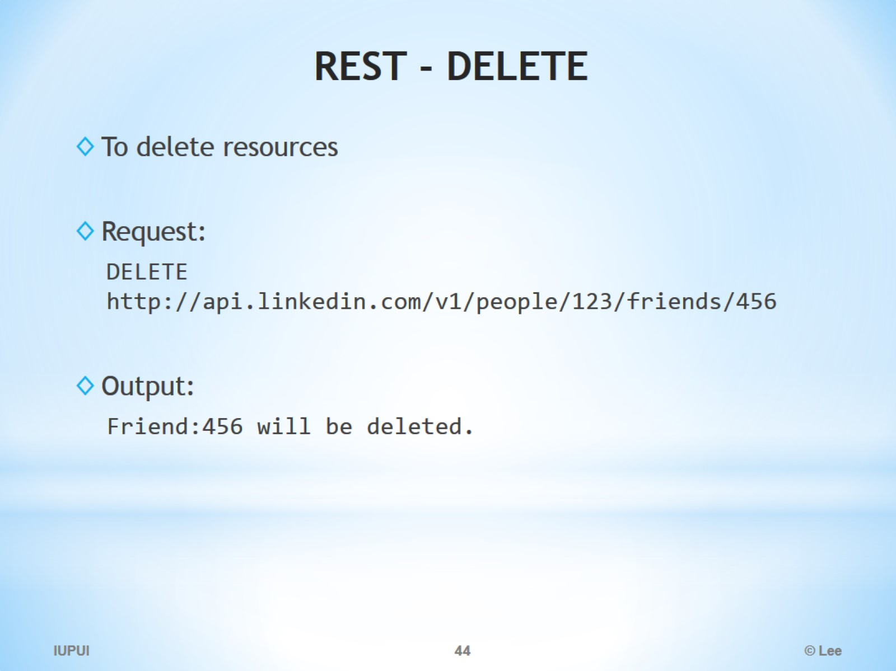
REST - DELETE

Slide 45
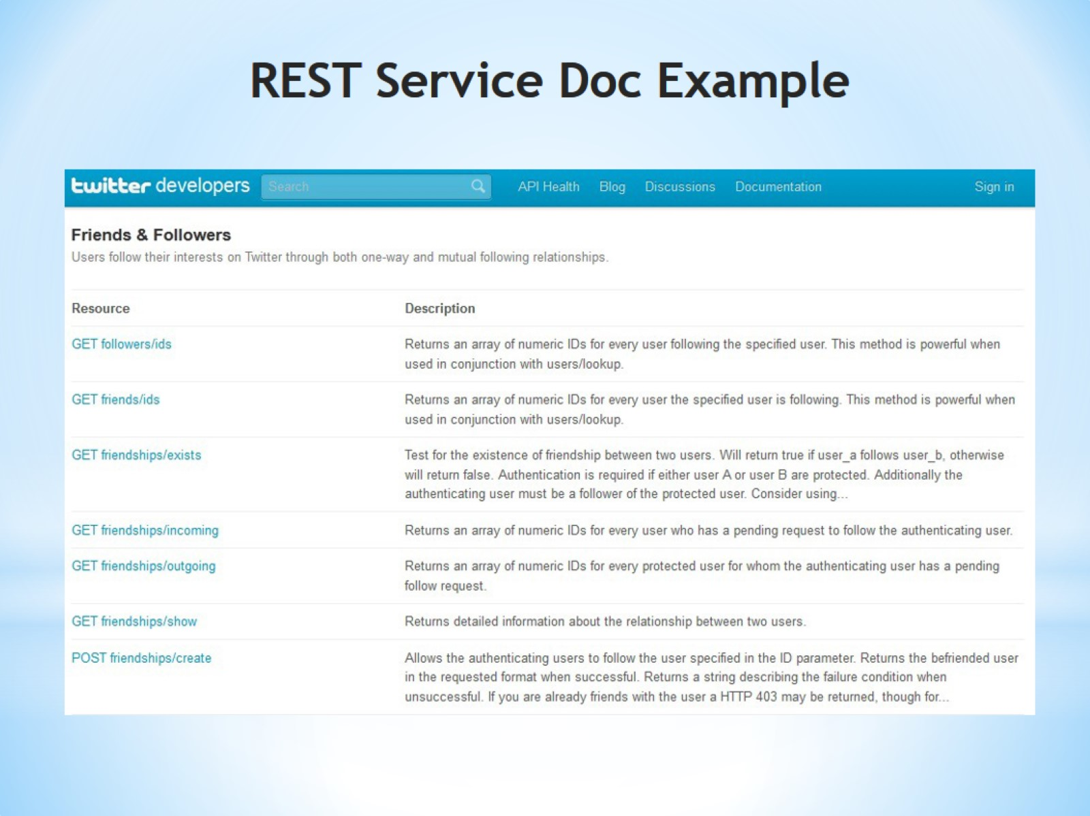
REST Service Doc Example

Slide 46
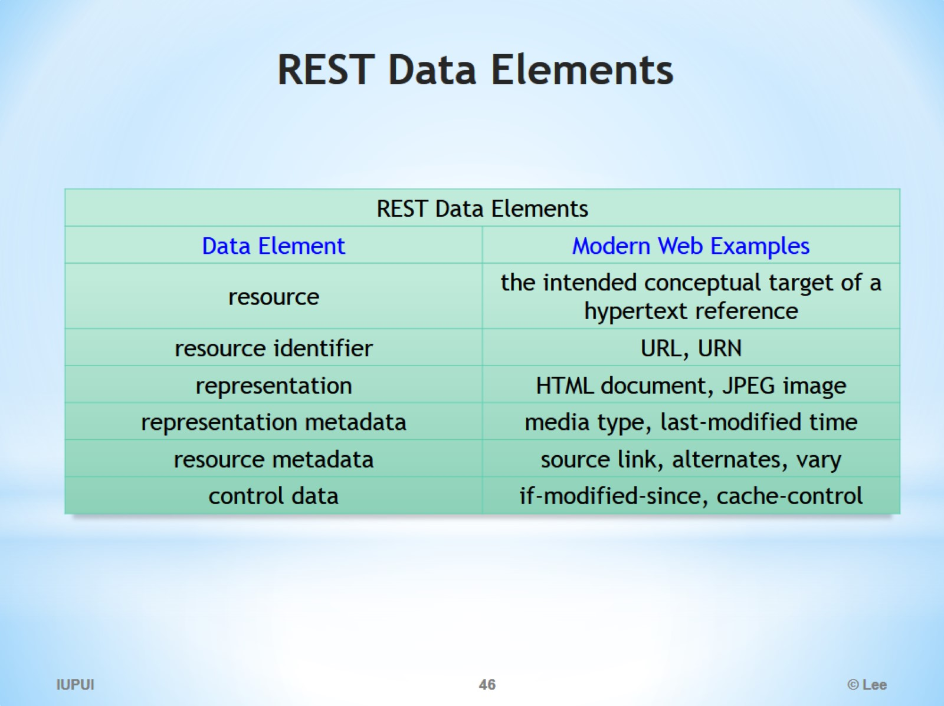
REST Data Elements

Slide 47
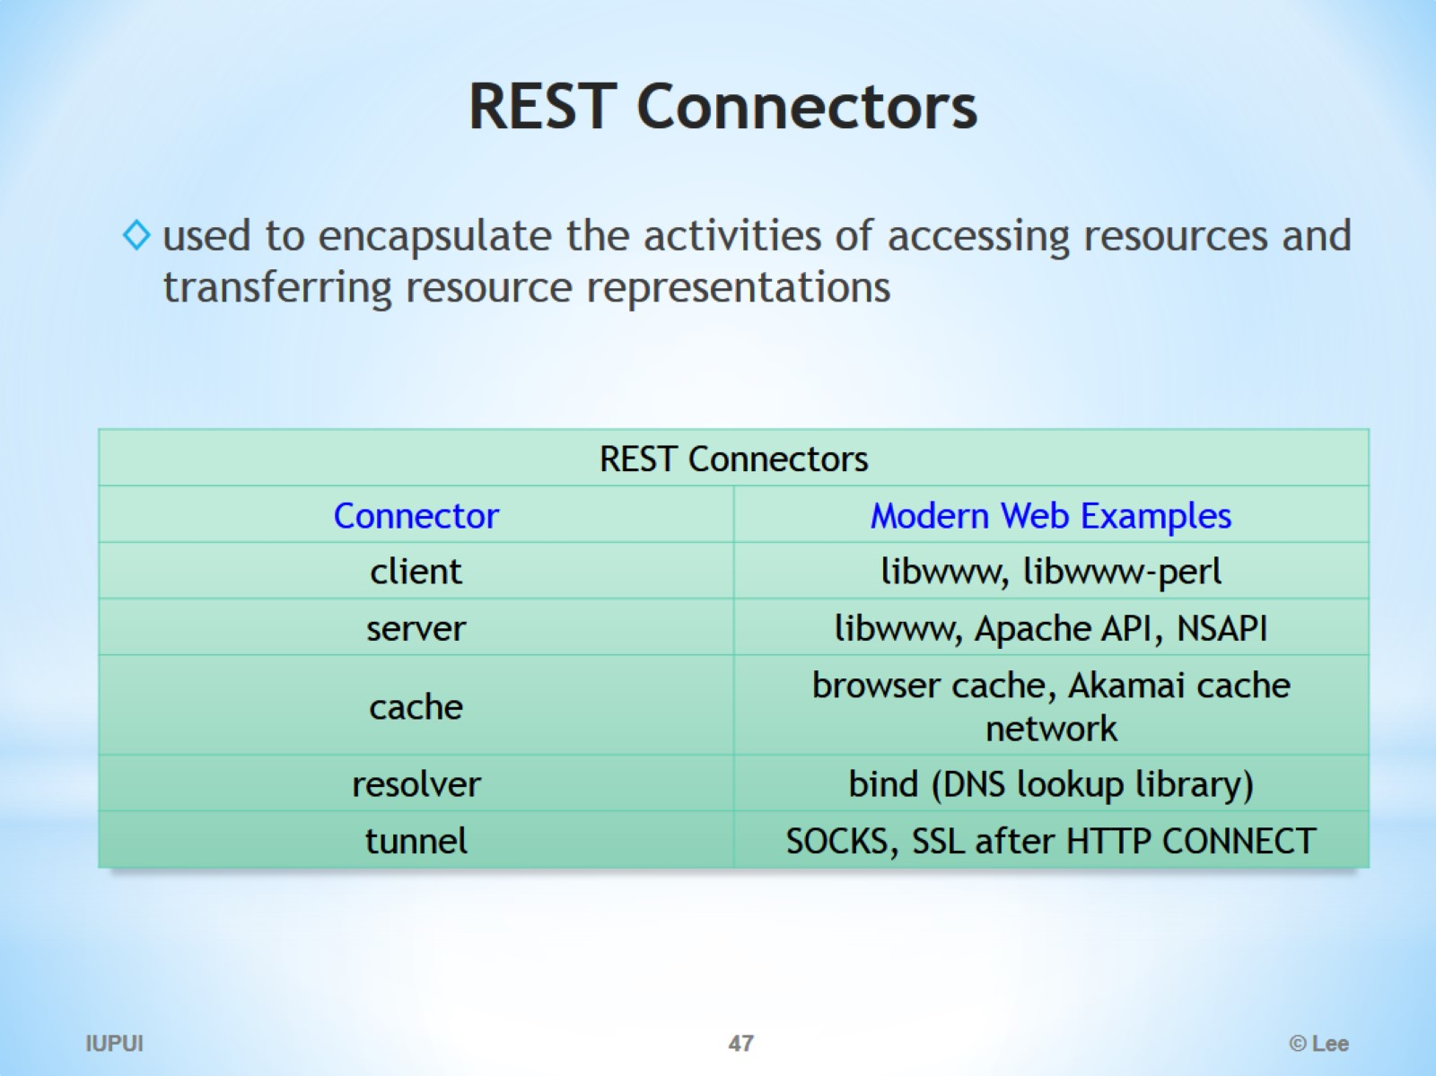
REST Connectors

Slide 48
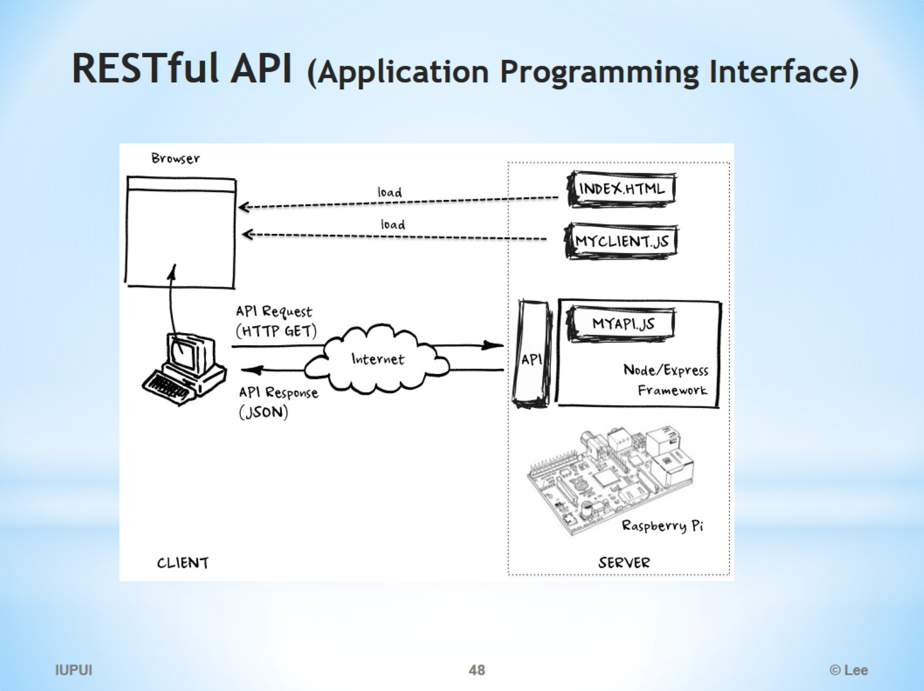
RESTful API (Application Programming Interface)

Slide 49
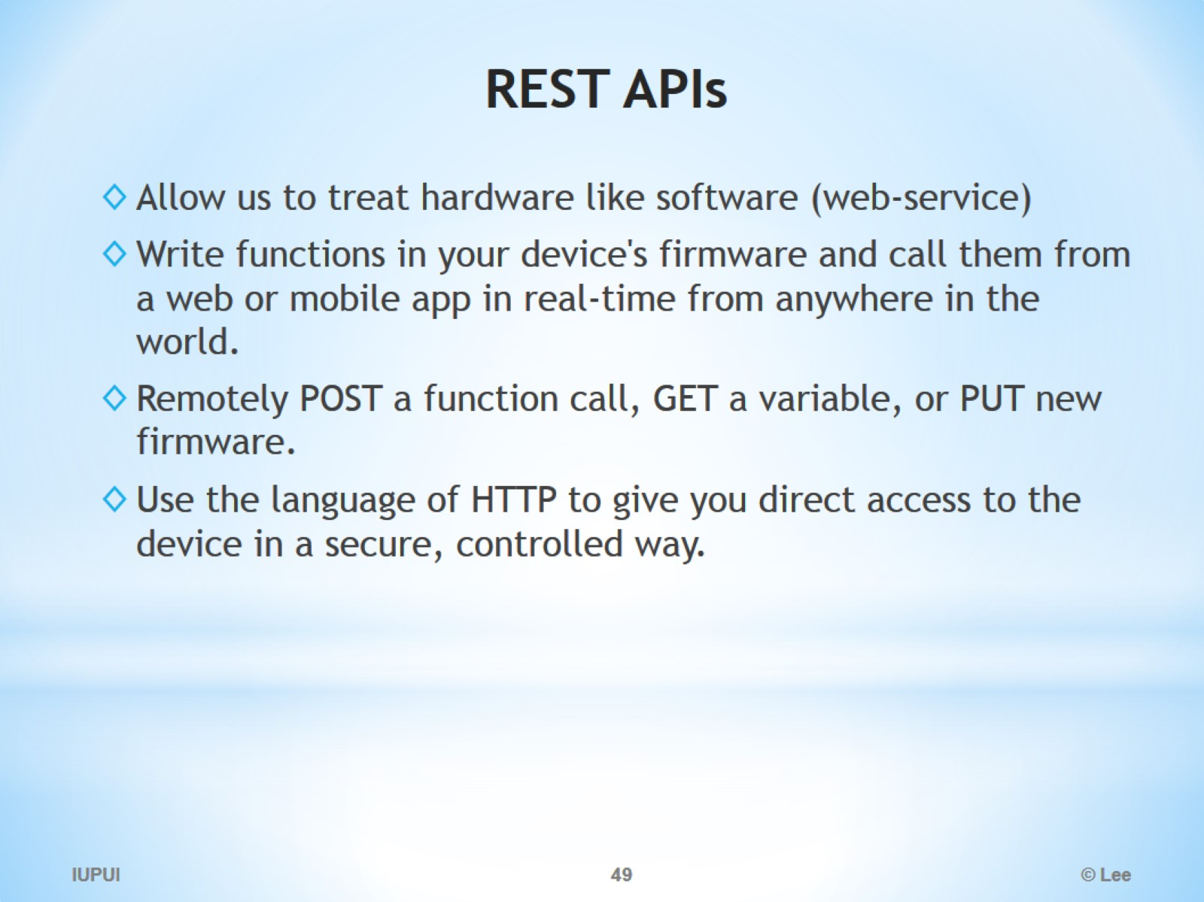
REST APIs

Slide 50
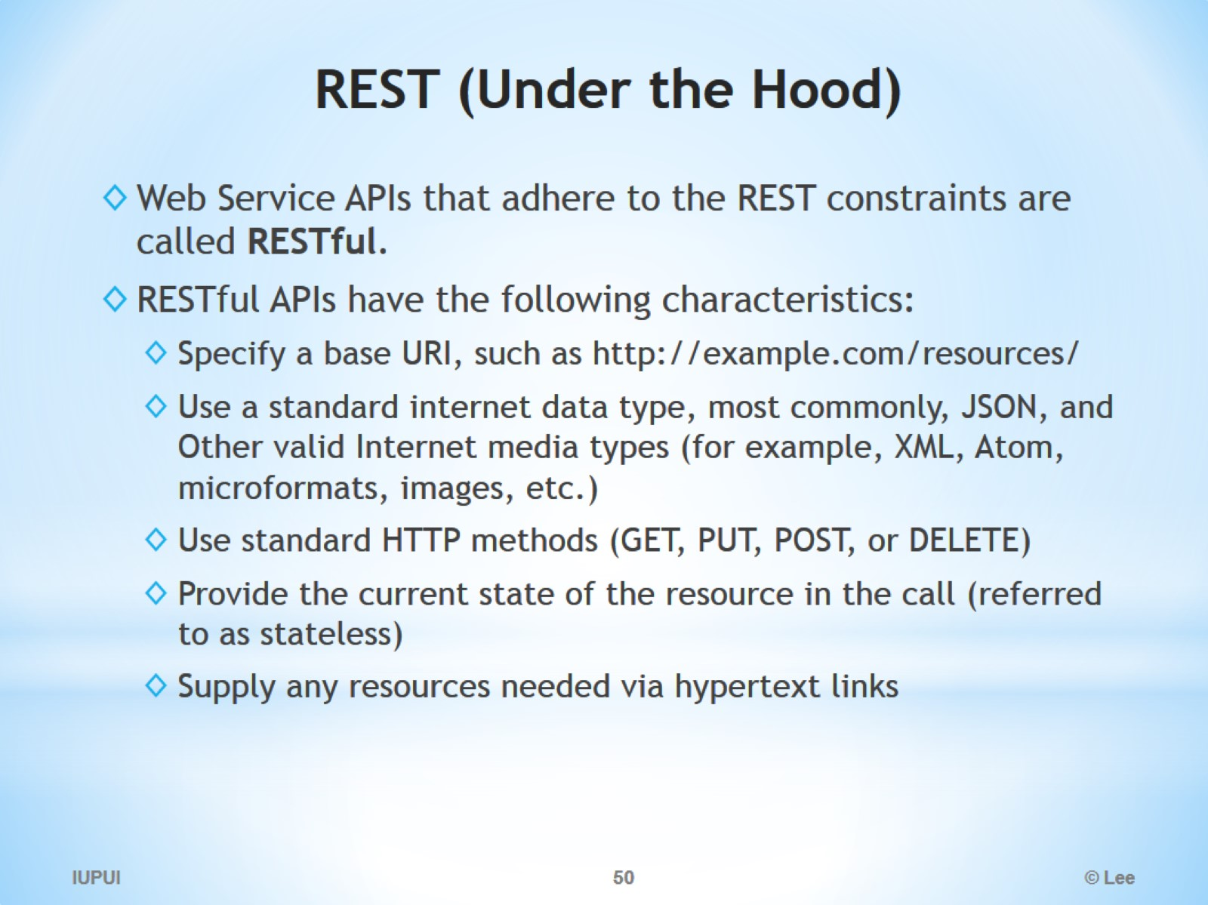
REST (Under the Hood)

Slide 51

RESTful services

Slide 52

RESTful services

Slide 53

RESTful Service Example

Slide 54

Who Uses REST?

Slide 55

REST vs. SOAP

Slide 56

REST vs. SOAP

Slide 57

Characteristics: Simplicity

Slide 58

Characteristics: Bandwidth!

Slide 59

Characteristics: Security!

Slide 60

SOAP or Restful

Slide 61

When to use

Slide 62

Why REST is better than SOAP for Web Services?

Slide 63

SOAP vs. REST

Slide 64

Web Application Description Language (WADL)

Slide 65

OData

